Slide 1
Science Olympiad Photo Quiz
Page 2 birds:
First, you’ll see a photo showing just enough to allow you to clinch the ID. Then, you’ll see the full photo with the name and perhaps some ID tips on specimens (not field ID)

Slide 2
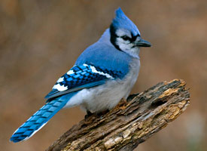

Slide 4
Blue Jay (Corvidae)

Slide 5
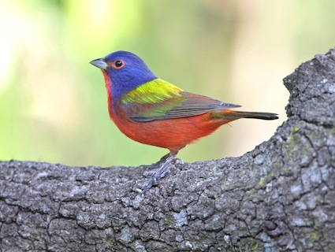

Slide 7
Painted Bunting (Cardinalidae)

Slide 8
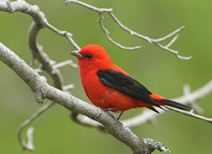

Slide 10
Scarlet Tanager (Cardinalidae)

Slide 11
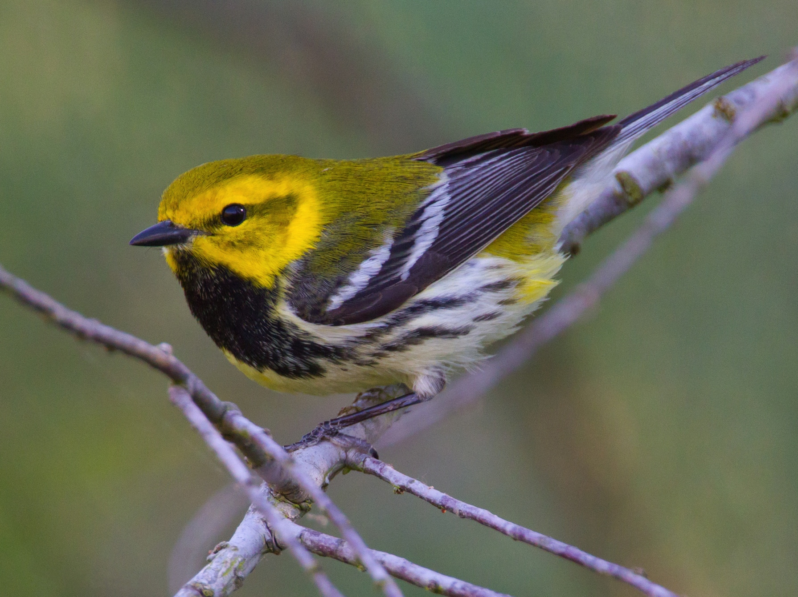

Slide 13
Black-throated Green Warbler (Parulidae)

Slide 14
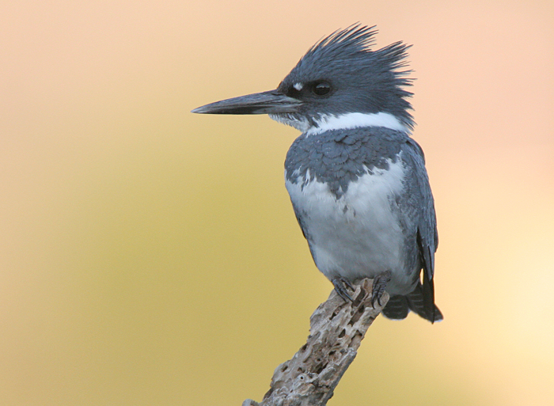

Slide 15
Notes:
Belted Kingfisher, Alcedinidae, Coraciiformes.

Slide 16
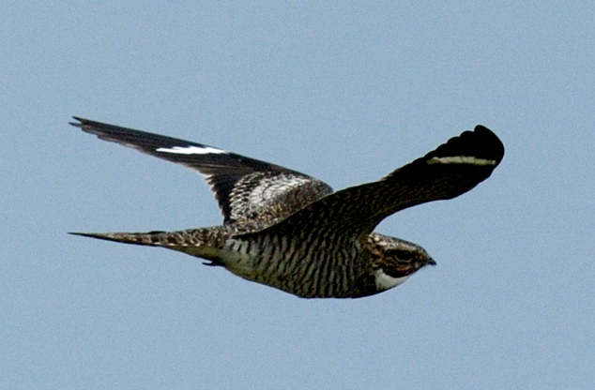

Slide 17
Notes:
Common Nighthawk, Caprimulgidae, Caprimulgiformes. Very short bill = screener. White patch in primaries and on lower throat eliminates any other nightjar or Chimney Swift.

Slide 18
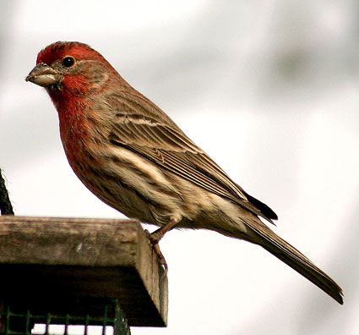

Slide 20
Head color variable, but flanks and belly always streaked.
House Finch (Fringillidae)

Slide 21
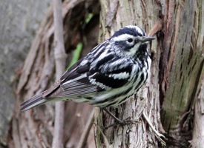

Slide 23
Black-and-white Warbler (Parulidae)

Slide 24
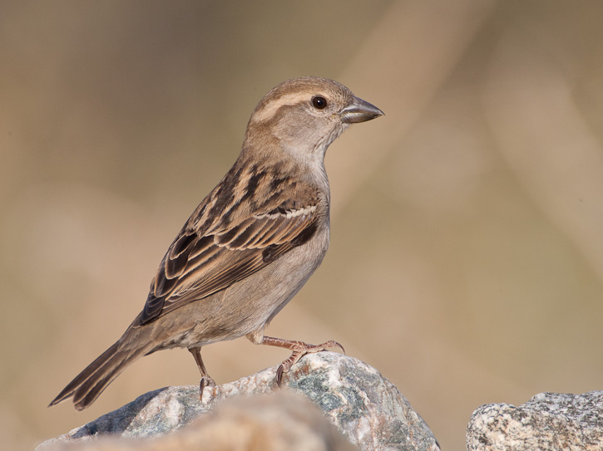

Slide 26
Plain face, plain brown crown, broad pale superciliary … likes Doritos, fries
House Sparrow (Passeridae)

Slide 27
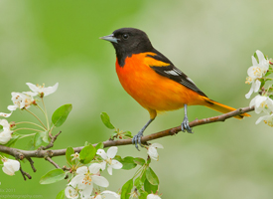

Slide 29
Baltimore Oriole (Icteridae)

Slide 30
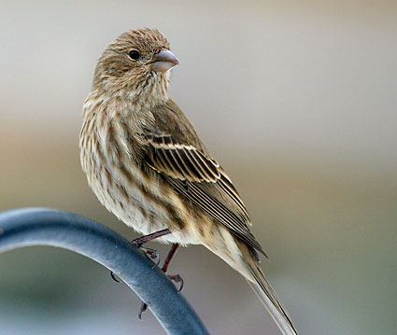

Slide 32
Very plain face, heavily streaked
House Finch female (Fringillidae)

Slide 33
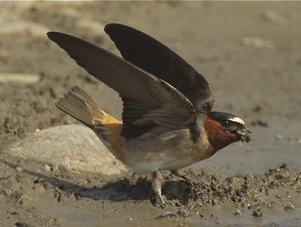

Slide 35
“Orange” rump, pale forehead, chestnut throat …
Cliff Swallow (Hirundinidae)

Slide 36
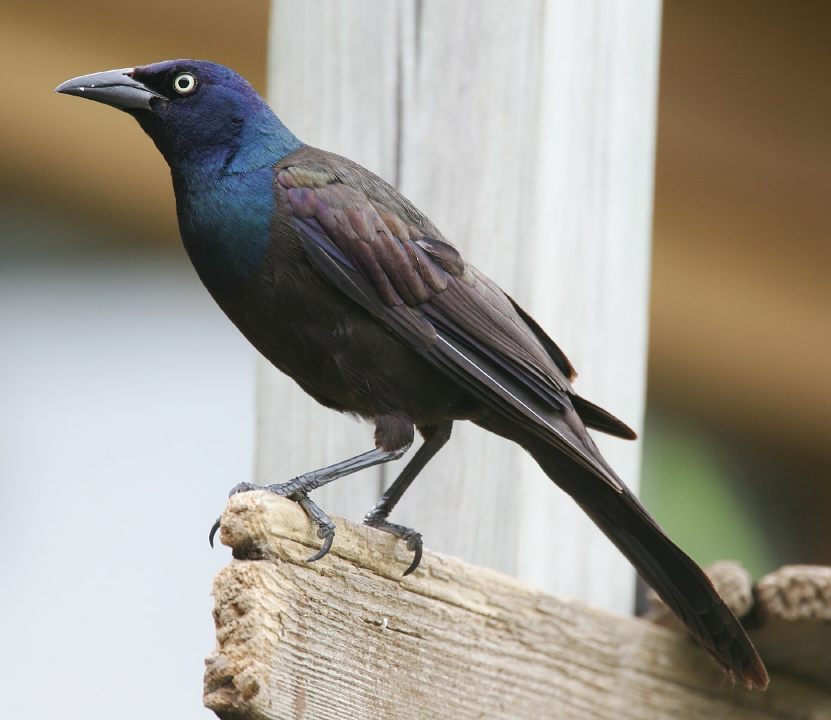

Slide 38
Note contrast between breast, back, and upperwing coverts … compare to Boat-tailed.
Common Grackle (Icteridae)

Slide 39
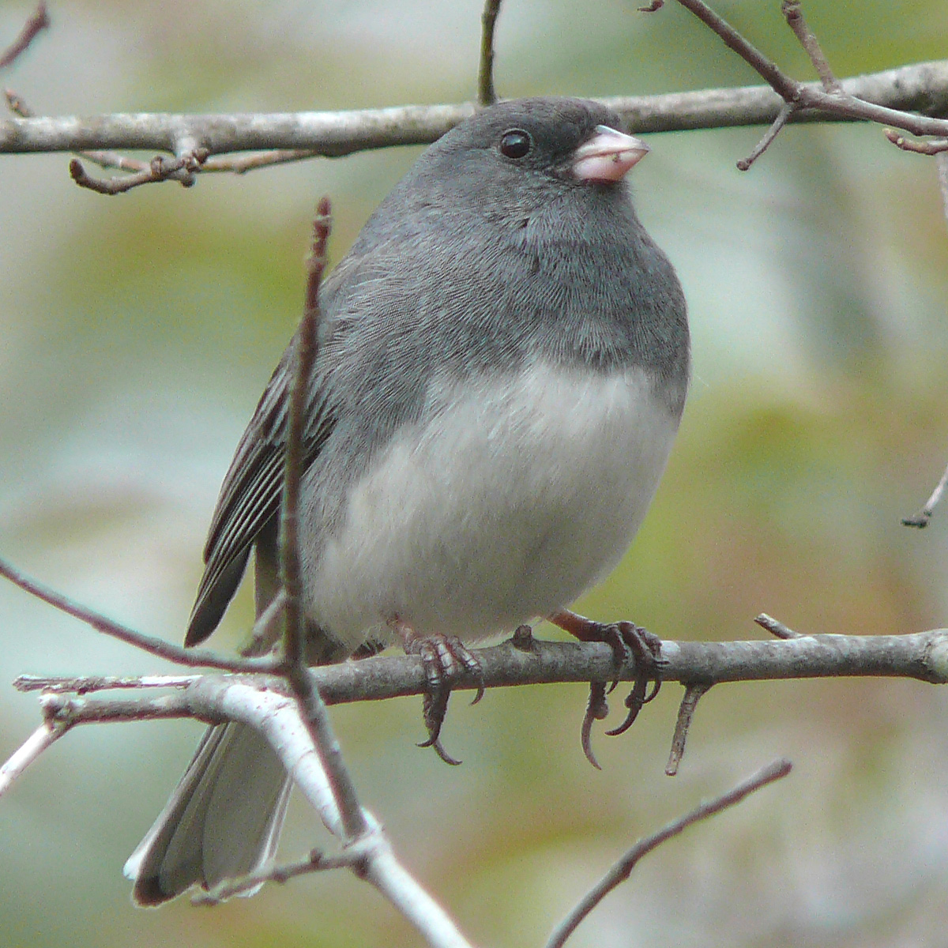

Slide 41
All gray except for white belly and outer rectrices.
Dark-eyed Junco (Emberizidae)

Slide 42
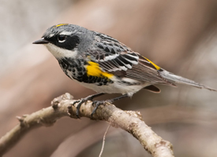

Slide 44
Only Magnolia Warbler also has a yellow rump.
Yellow-rumped Warbler (Parulidae)

Slide 45
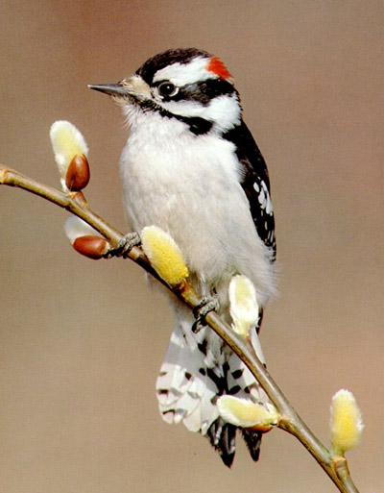

Slide 46
Notes:
Downy Woodpecker, Picidae, Piciformes. The pointed central rectrices, which will be obviously stiffened in the hand, indicate woodpecker. White flanks and barred underside of rectrices eliminates all other woodpeckers. Note short bill, ca. ½ inch.

Slide 47
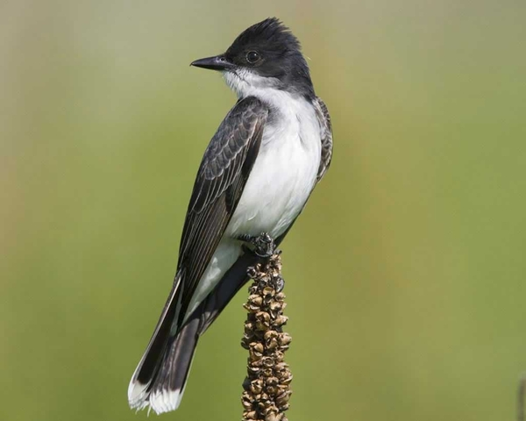

Slide 48
Notes:
Eastern Kingbird, Tyrannidae, Passeriformes. Those white-tipped rectrices are unique. From what you could see, the black tail and white undertail coverts also consistent with E. Kingbird.

Slide 49
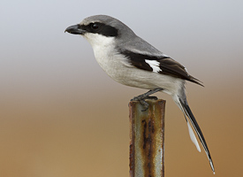

Slide 50
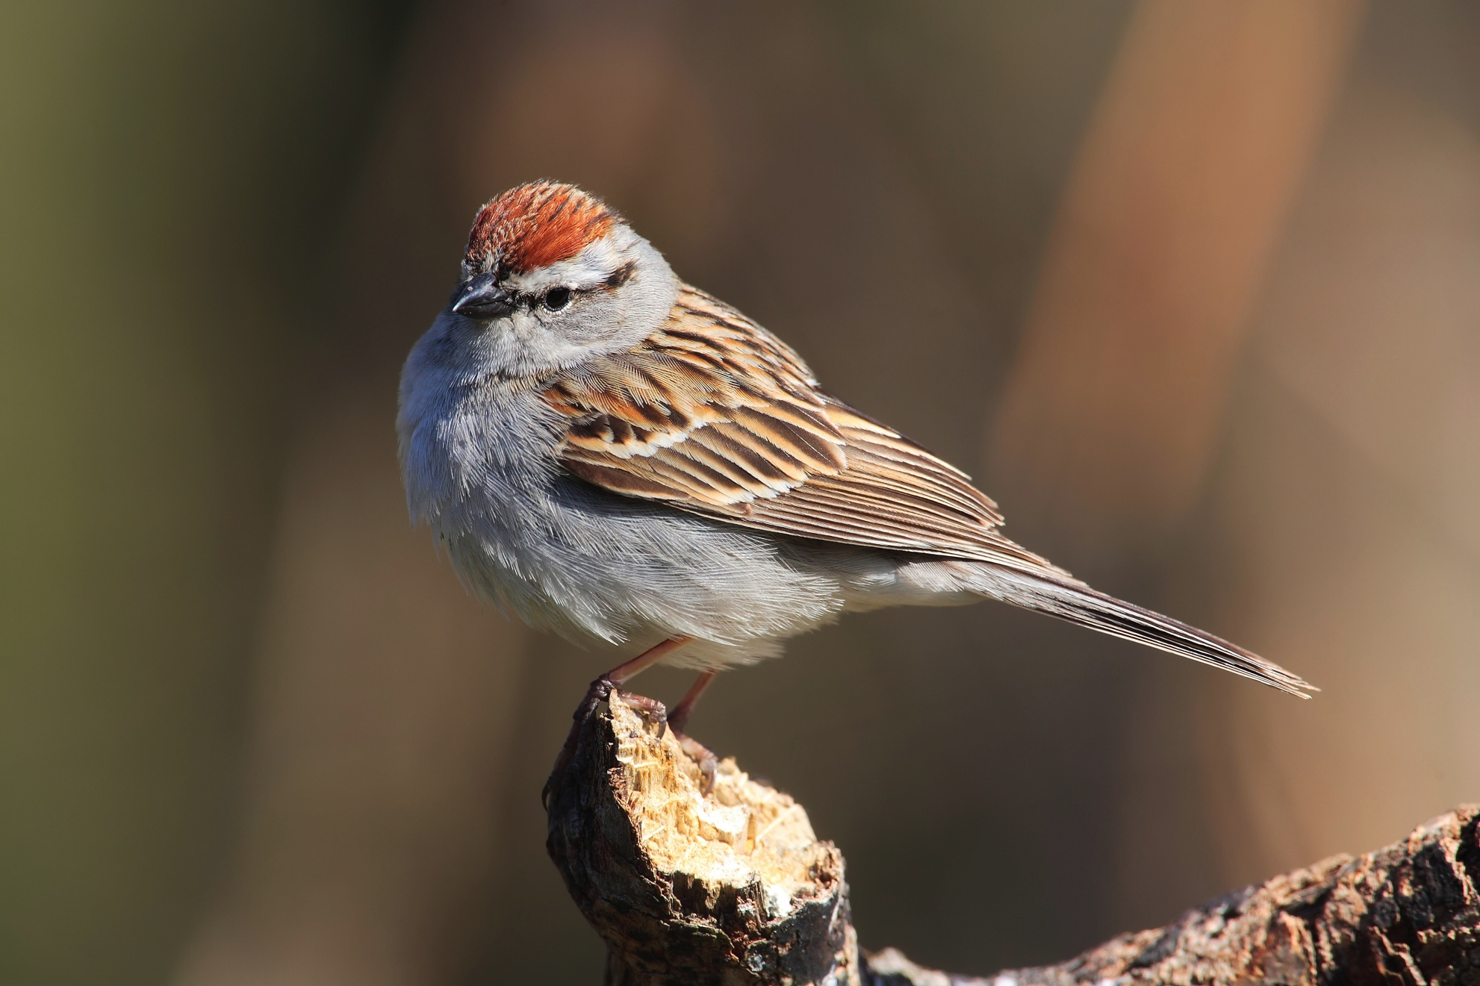

Slide 52
Reddish brown crown, pale superciliary, black eyeline extending into lores …
Chipping Sparrow (Emberizidae)

Slide 54
N. Mockingbird’s wing not as black, and white patches not as conspicuous in folded wing.
Black mask, gray crown, large insect/small invert bill …
Loggerhead Shrike (Laniidae)

Slide 55
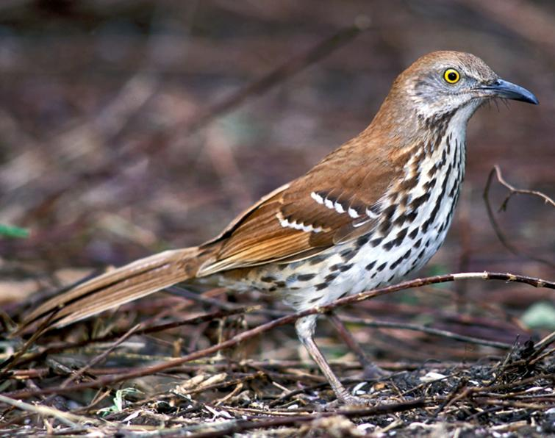

Slide 57
Reddish brown, two white wingbars, conspicuous streaks
Brown Thrasher (Mimidae)

Slide 58
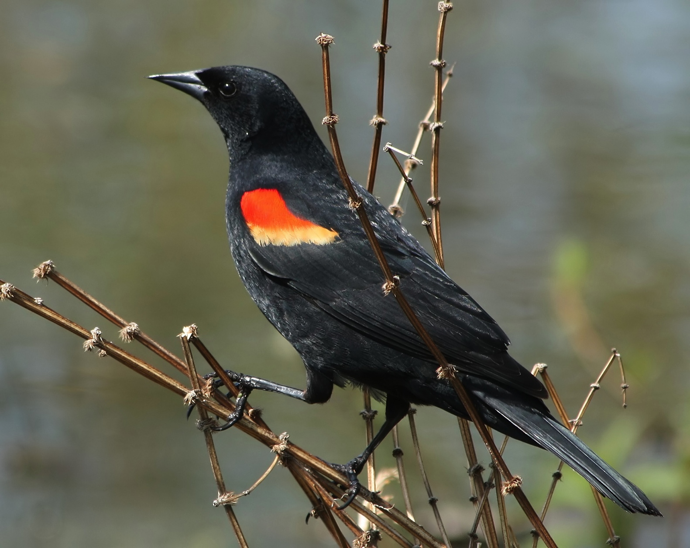

Slide 60
Red-winged Blackbird (Icteridae)

Slide 61
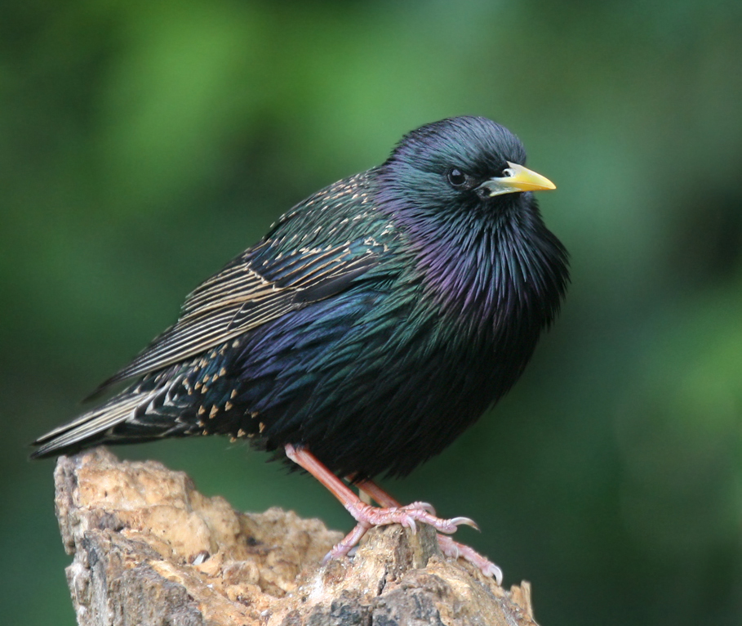

Slide 63
European Starling (Sturnidae)
Nothing else has breast feathers with that texture and color.

Slide 64
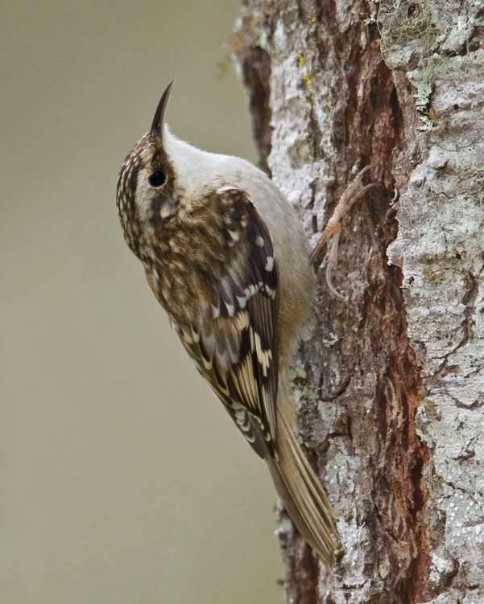

Slide 66
Note: not only would a wren lack the stiffened shafts of the central rectrices with bare tips, but also all wrens have barred rectrices.
Brown Creeper (Certhiidae)

Slide 67
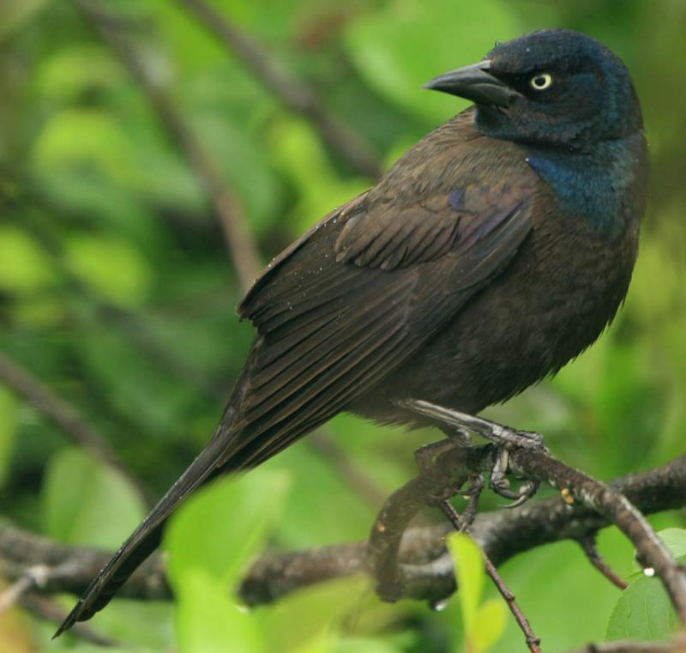

Slide 69
Like male, just duller
Common Grackle female (Icteridae)

Slide 70
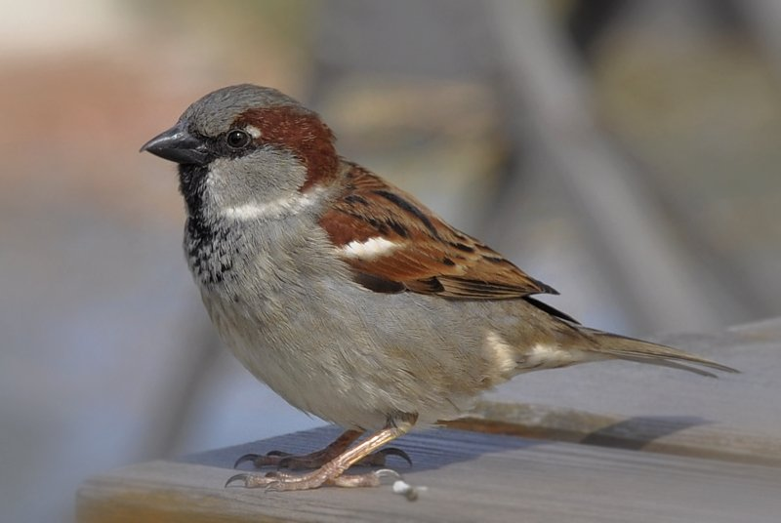

Slide 72
House Sparrow (Passeridae)

Slide 73
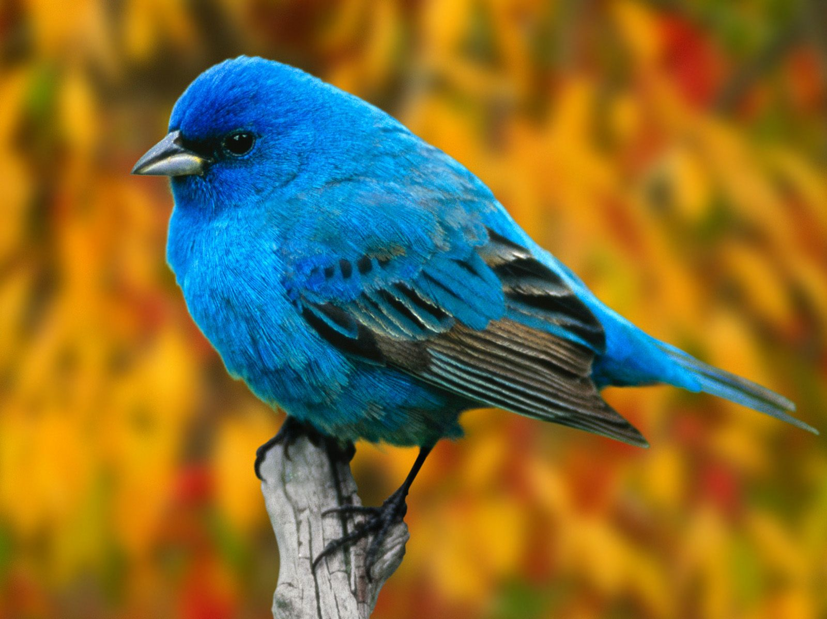

Slide 75
Indigo Bunting (Cardinalidae)

Slide 76
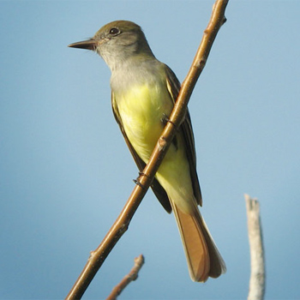

Slide 77
Notes:
Great Crested Flycatcher, Tyrannidae, Passeriformes. Bright rufous underside of tail distinctive, as is bright belly and undertail coverts. Note gray throat and breast, sallyer bill.

Slide 78
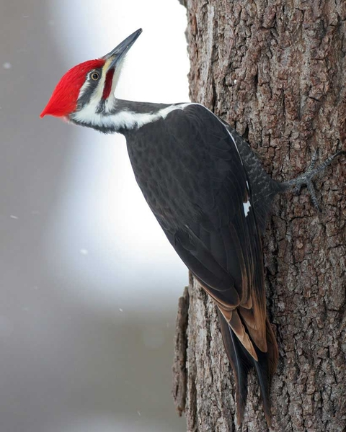

Slide 79
Notes:
Pileated Woodpecker, Picidae, Piciformes

Slide 80
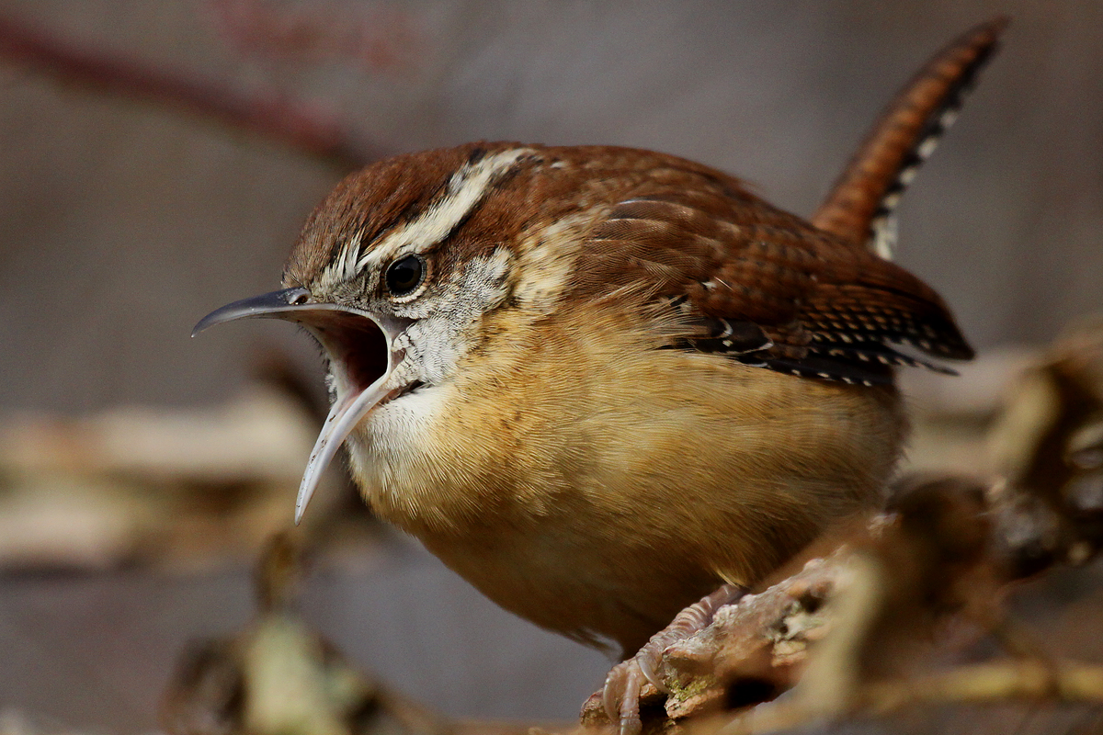

Slide 82
Carolina Wren (Troglodytidae)

Slide 83
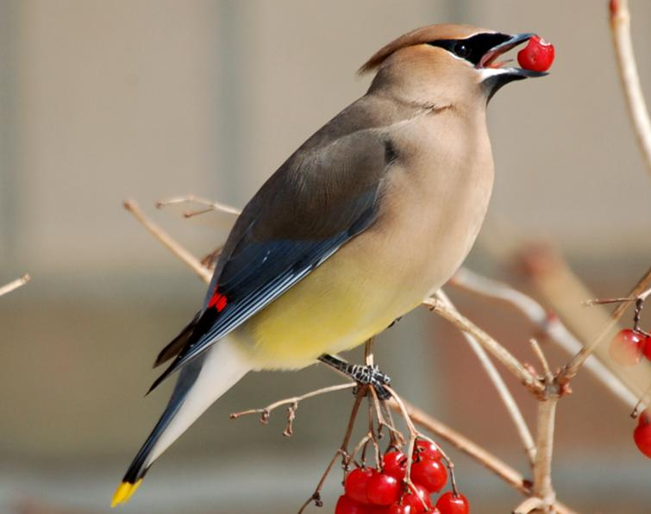

Slide 85
Cedar Waxwing (Bombycillidae)

Slide 86
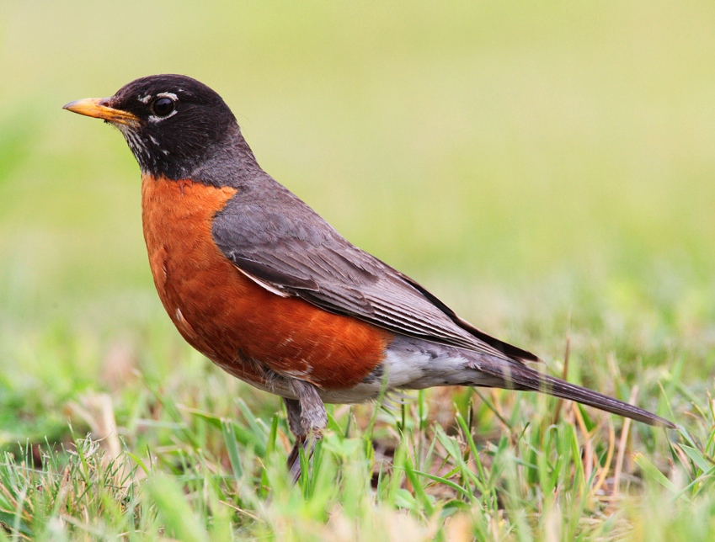

Slide 88
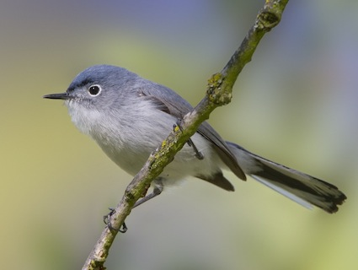

Slide 90
“Blue” above, pale gray below, distinctive black line on forehead extending to anterior portion of superciliary.
Note also black and white tail.
Blue-gray Gnatcatcher (Polioptilidae)

Slide 91
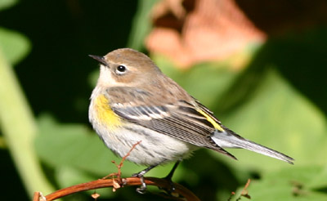

Slide 93
Yellow-rumped Warbler, non-breeding plumage (Parulidae)

Slide 94
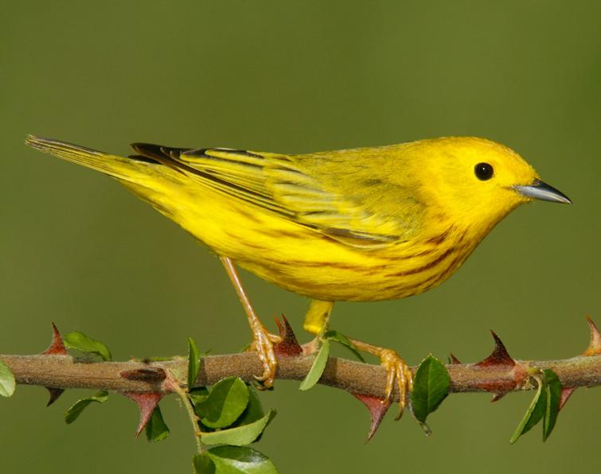

Slide 96
Yellow Warbler (Parulidae)

Slide 97
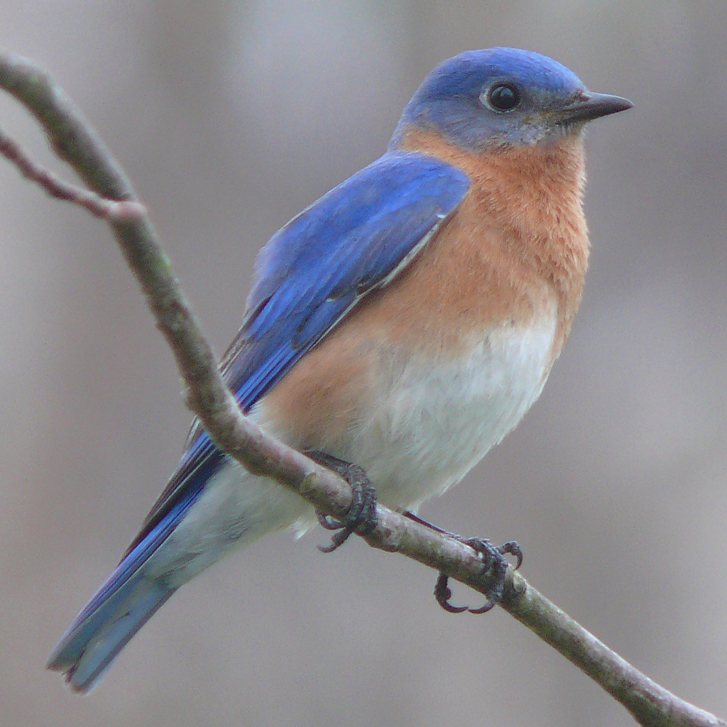

Slide 99
Compare tail to Blue Jay’s
Eastern Bluebird (Turdidae)

Slide 100
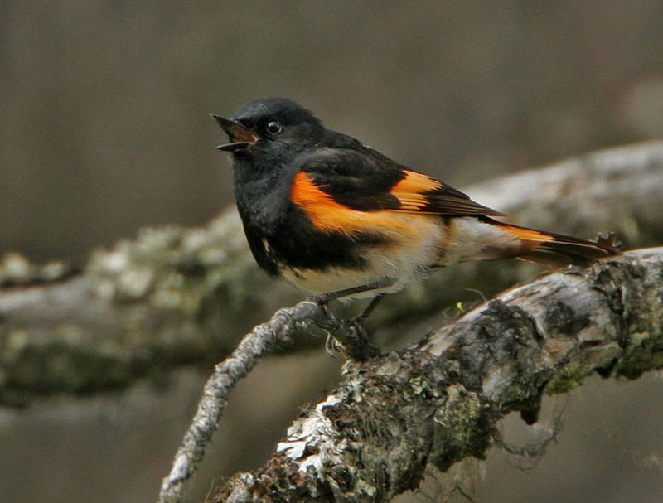

Slide 102
American Redstart (Parulidae)

Slide 103
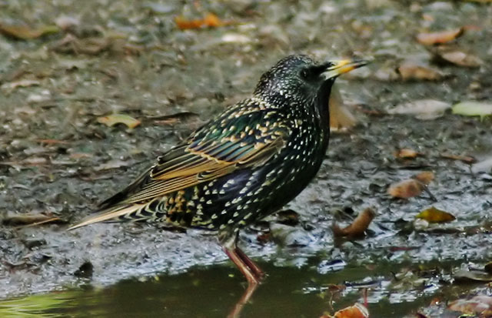

Slide 105
European Starling (Sturnidae)

Slide 106
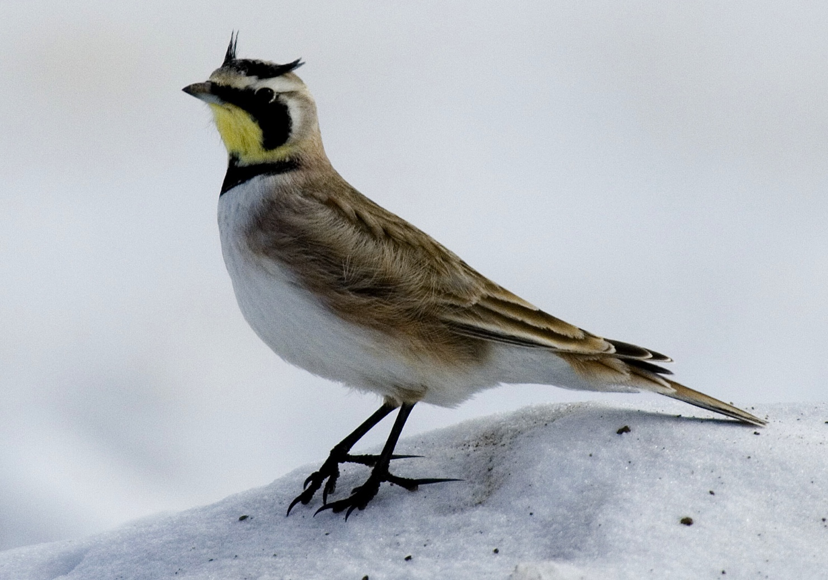

Slide 108
Face pattern unique; note that the horns will be flattened against crown on specimen.
Bill intermediate between insectivore and seed-crusher.
None of your other birds has a hind toenail that is straight and 2-3X as long as other toenails.
Horned Lark (Alaudidae)

Slide 109
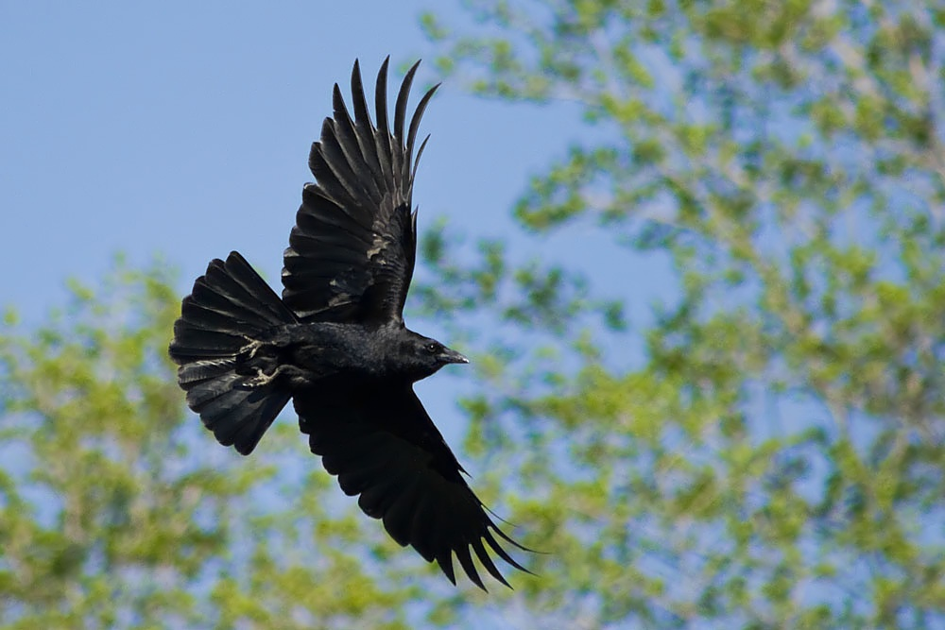

Slide 111
The only two all-black birds are the two crows. From there, use wing formula … which is hard to tell in photos, but here #9 seems to be substantially longer than #5
American Crow (Corvidae)

Slide 112
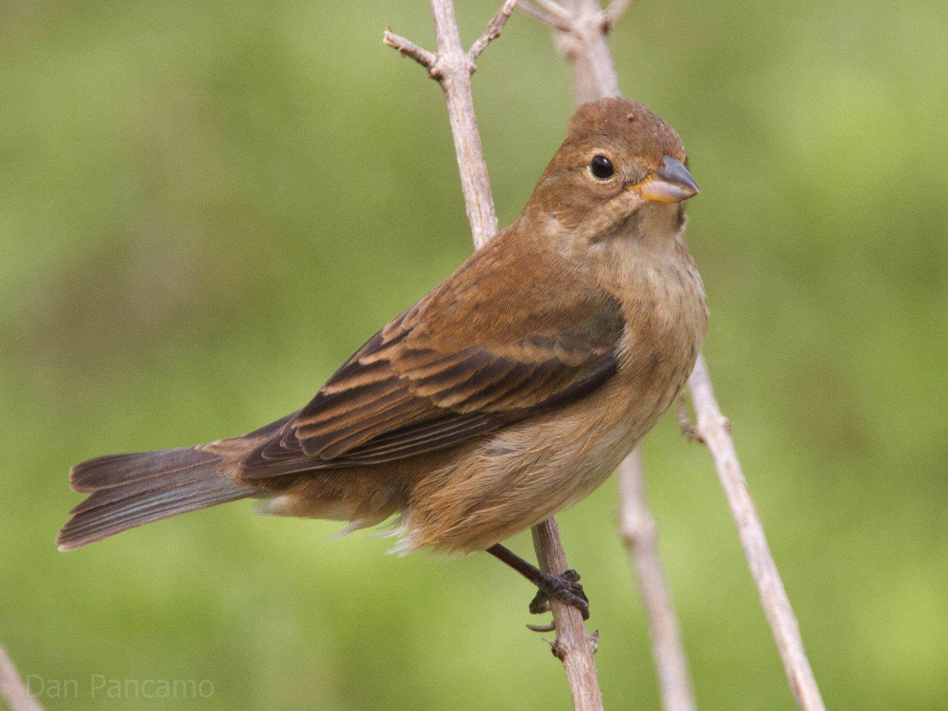

Slide 114
Only seed-crusher with nearly unmarked head and back.
Indigo Bunting female (Cardinalidae)

Slide 115
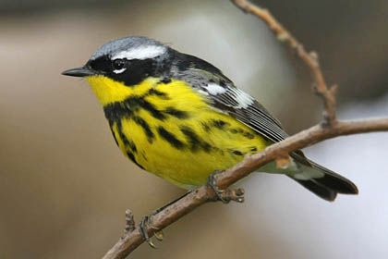

Slide 117
Magnolia Warbler (Parulidae)

Slide 118
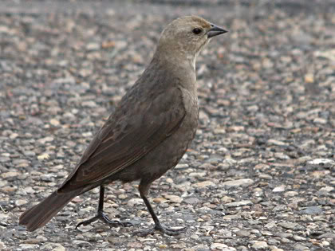

Slide 120
Note the seed-crusher bill.
There really isn’t any other species that has this shade of dark brownish gray.
Brown-headed Cowbird (Icteridae)

Slide 121
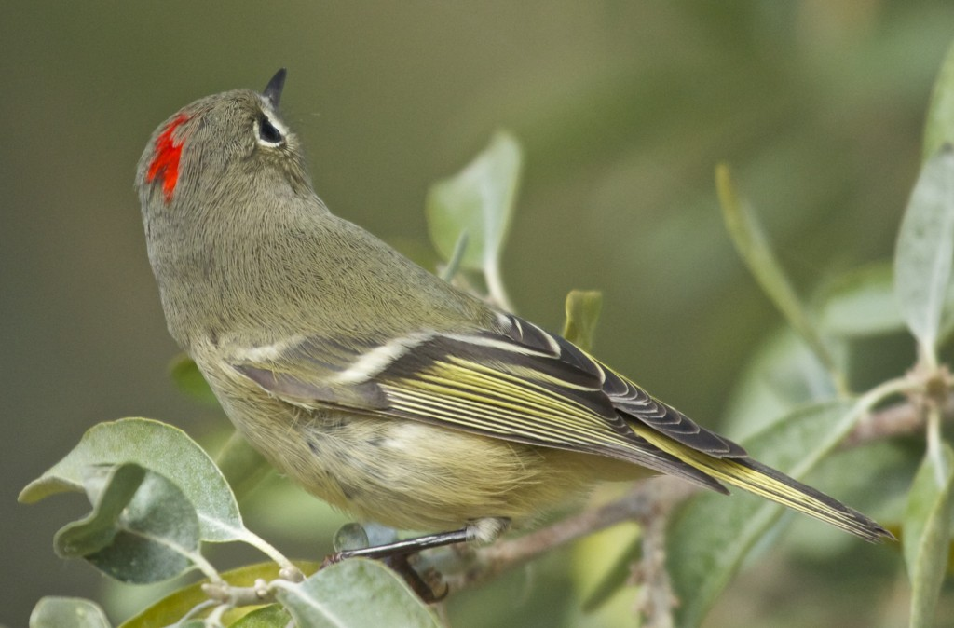

Slide 123
Ruby-crowned Kinglet (Regulidae)

Slide 124
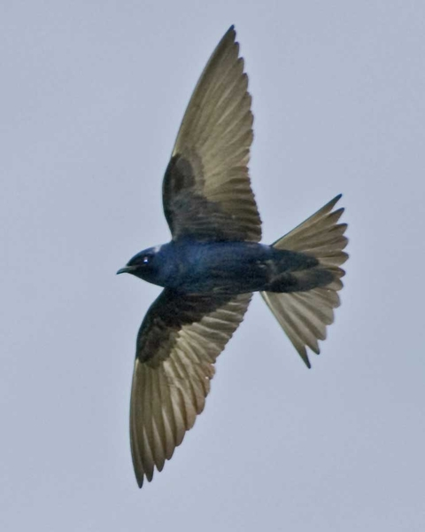

Slide 126
Purple Martin – male (Hirundinidae)

Slide 127
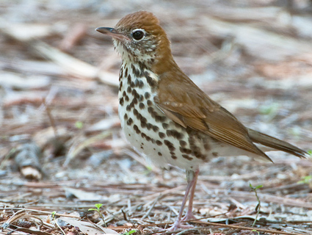

Slide 129
Unmarked brown upperparts, no wingbars, spots on breast = one of the thrushes
Crown more reddish than any other part of upperparts = Wood
Wood Thrush (Turdidae)

Slide 130
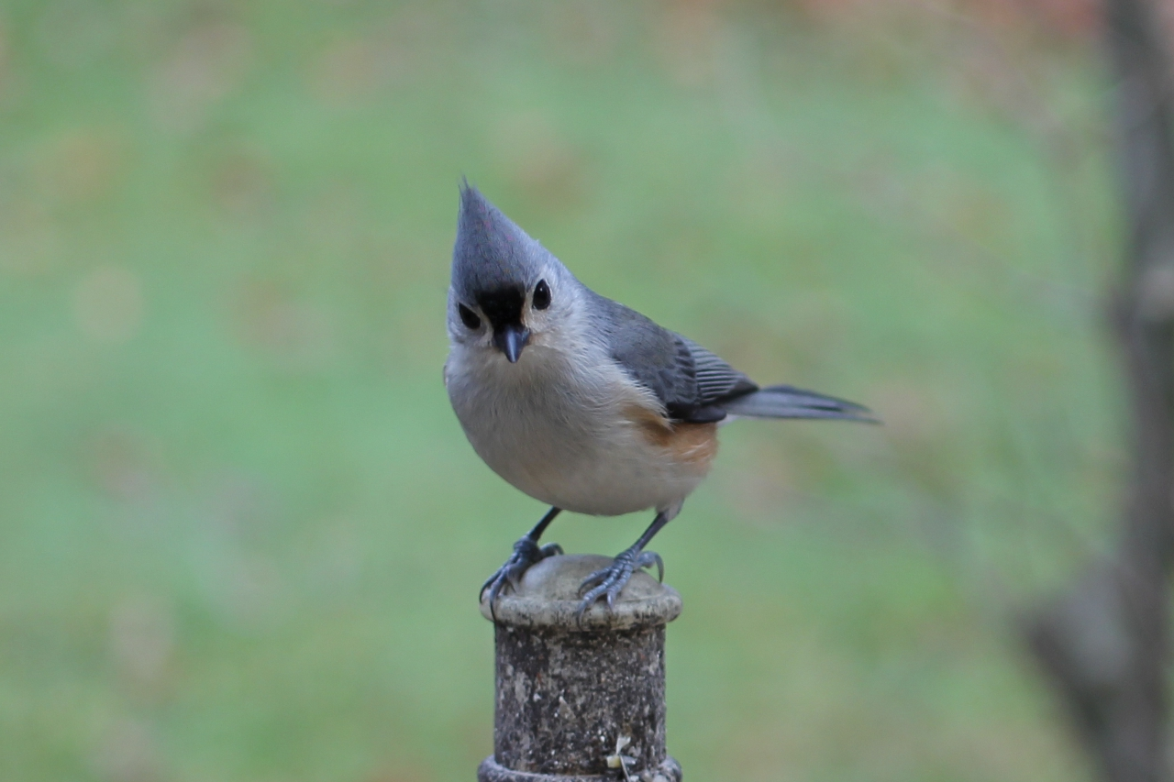

Slide 132
Note also the tawny flanks.
Tufted Titmouse (Paridae)

Slide 133
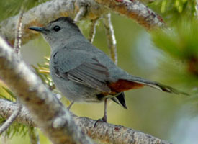

Slide 135
Gray with chestnut undertail coverts
Gray Catbird (Mimidae)

Slide 136
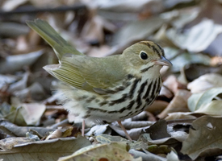

Slide 138
Ovenbird (Parulidae)

Slide 139
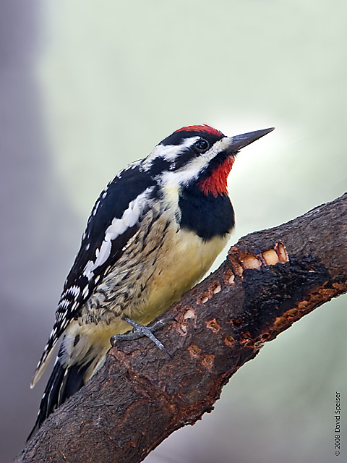

Slide 140
Notes:
Yellow-bellied Sapsucker, Picidae, Piciformes.

Slide 141
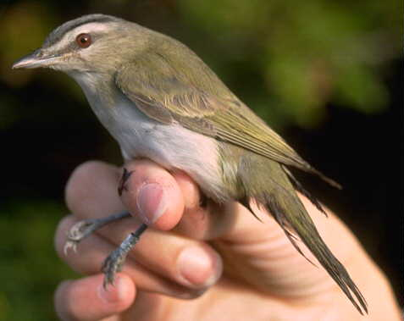

Slide 143
If only the head were visible, this would have been really easy: gray crown narrowly bordered dark gray; broad whitish superciliary; dark eyeline, pale throat.
BUT … you have no other birds in this week’s group that are greenish above ad whitish below that do NOT have wingbars.
Red-eyed Vireo (Vireonidae)

Slide 144


Slide 146
Kentucky Warbler (Parulidae)

Slide 147


Slide 149
Do not confuse this with any sparrow, none of which are are dramatically streaked below.
Note faint reddish suffusion in the face and throat; the extent is highly variable but it is almost always present.
Red-winged Blackbird female (Icteridae)

Slide 150


Slide 152
None of your other species has grayish crown and back, fairly plain face, whitish throat.
Northern Mockingbird (Mimidae)

Slide 153


Slide 155
As long as you can figure out that you were looking at a tail, this one is easy …
Barn Swallow (Hirundinidae)

Slide 156


Slide 158
Yellow crown with black border, broad white superciliary, blurry black eyeline
Golden-crowned Kinglet (Regulidae)

Slide 159


Slide 161
The barred rectrices get you to “wren”; then, striped back eliminates all but Sedge …
… then, solid crown and prominent superciliary eliminate Sedge.
Marsh Wren (Troglodytidae)

Slide 162


Slide 164
Note the yellowish color in the face.
Nothing else has those jet black wings and white wingbars.
Note the short, forked tail
American Goldfinch (Fringillidae)

Slide 165


Slide 167
Brown-headed Cowbird (Icteridae)

Slide 168


Slide 170
Black mask bordered above by pale gray; yellow throat and upper breast. Note yellow does NOT extend into belly, as it does on most other species with black in face and yellow underparts.
Common Yellowthroat (Parulidae)

Slide 171


Slide 173
… then, violet crown and dark throat eliminate everything else
Very long wings and long primary extension get you to “swallow” …
Purple Martin – female (Hirundinidae)

Slide 174


Slide 175
Notes:
Ruby-throated Hummingbird, Trochilidae, Apodiformes: note the thin flower-prober bill.

Slide 176


Slide 177


Slide 178


Slide 179


Slide 180


Slide 181


Slide 182


Slide 183


Slide 184
Now, make your own quiz using photos you can grab online, for the following page 1 species not represented here. (I may use the best ones for your future quizzes):
Chuck-will’s-widow
Red-headed Woodpecker
Northern Flicker
Warbling Vireo
Steller’s Jay
Black-billed Magpie
Black-capped Chickadee
Red-breasted Nuthatch
White-breasted Nuthatch
Cactus Wren
American Dipper
Spotted Towhee
Black-chinned Sparrow
Lapland Longspur
Snow Bunting
Northern Cardinal
Bobolink
Yellow-headed Blackbird
Red Crossbill
Evening Grosbeak
Pine Siskin

