Slide 1
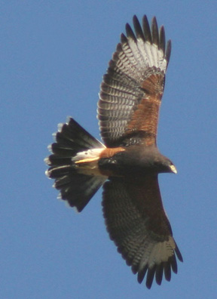
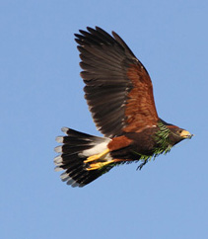
Taxonomic status of Bay-winged Hawk Parabuteo (unicinctus) unicinctus and Harris’s Hawk P. (u.) harrisi, with documentation of delayed plumage maturation in Bay-winged Hawk
Bill Clark & Sergio Seipke
Bay-winged Hawk Harris’s Hawk

Slide 2
The two populations of Parabuteo unicinctus have long been treated by taxonomic authorities & World bird checklists as two subspecies:
Harris’s Hawk P. u. harrisi in North & Central America, &
Bay-winged Hawk P. u. unicinctus in South America.
However, they differ in plumages and behavior to such an extent that they should be considered separate species.

Slide 3
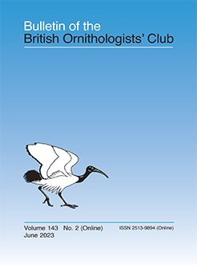
We published these results in the Bulletin of the British Ornithological Club this year.
The article is available free on-line at the Bull BOC web site.
https://bioone.org/journals/bulletin-of-the-british-ornithologists-club/volume-143/issue-2/bboc.v143i2.2023.a2/Taxonomic-status-of-Bay-winged-Hawk-Parabuteo-unicinctus-unicinctus-and/10.25226/bboc.v143i2.2023.a2.full

Slide 4
We studied these taxa in the field in North and South America and examined 119 specimens (14 major museums) and >100 photographs, as well as reviewed their literature.
Further, we examined numerous photographs of both on-line, especially on Wikiaves &
Macauley bird collection.
Our on-line article incudes many pointers (URLs) to photos of both taxa at various ages in these collections.

Slide 5
The two taxa differ considerably in plumages and some behaviors. Adult plumages differ in color of undersides of remiges, & in markings on throat, undersides, leg feathers, & tail.
Argentina Texas
BWH – Pale remiges
HH – Dark remiges

Slide 6
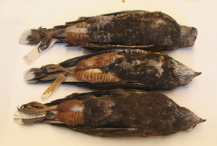
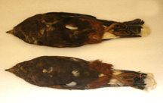
Adult plumages differ in markings on throat, undersides, leg feathers, and tail.
U Michigan
Museum Comparative Zoology
BWH – Pale throat, barred leg feathers, pale marking on body,
HH – Dark throat, solid rufous leg feathers, and dark body.

Slide 7
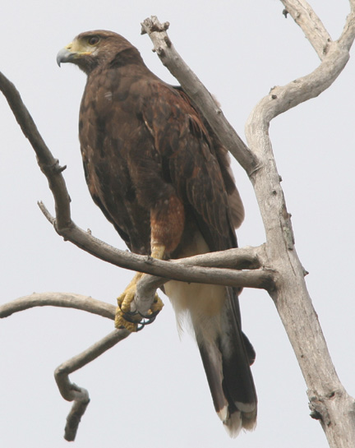
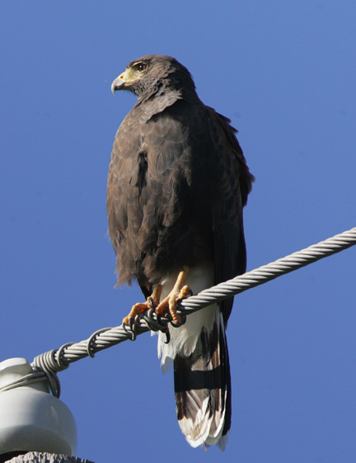
Adult plumages differ in width of white terminal band, wider on Harris’s Hawk.
Venezuela Texas
BWH
HH

Slide 8
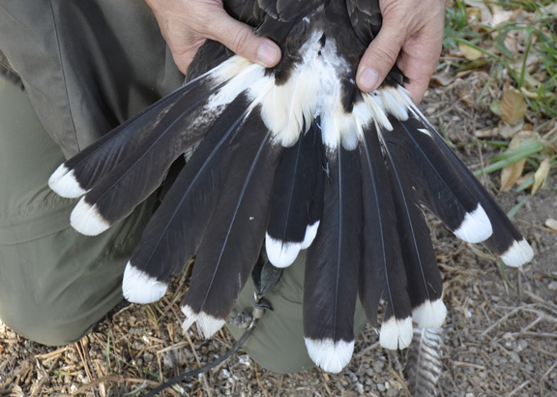
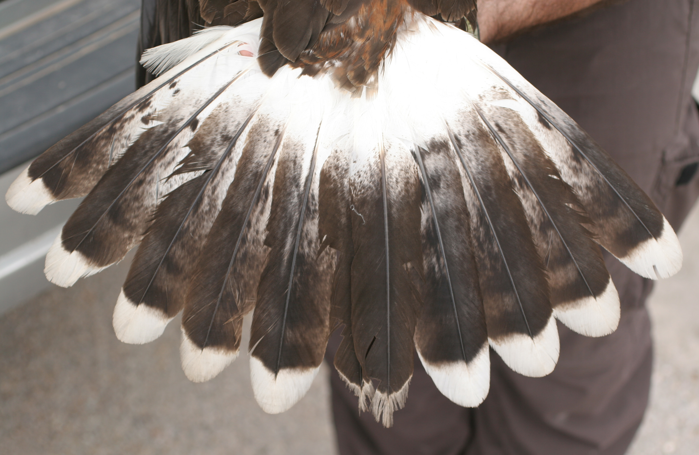
Adult plumages differ in width of white at the base of the tail & terminal band, wider on Harris’s Hawk.
Lee Jones
Peru
Texas
BWH
HH

Slide 9
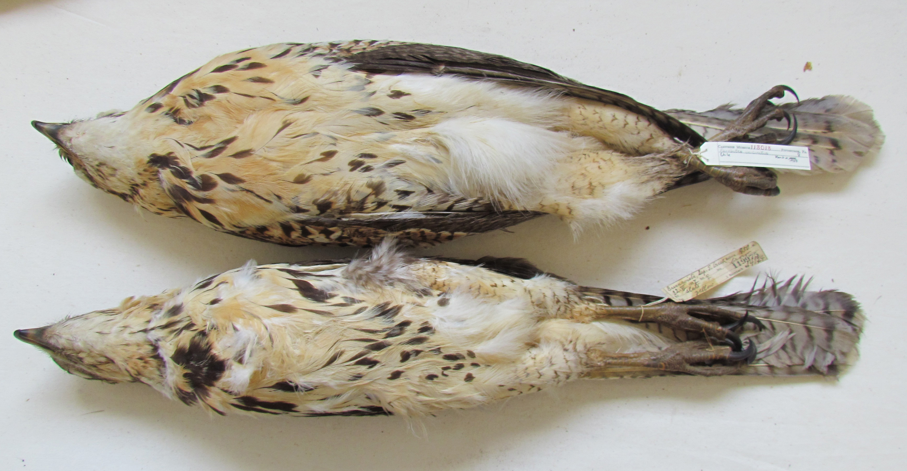
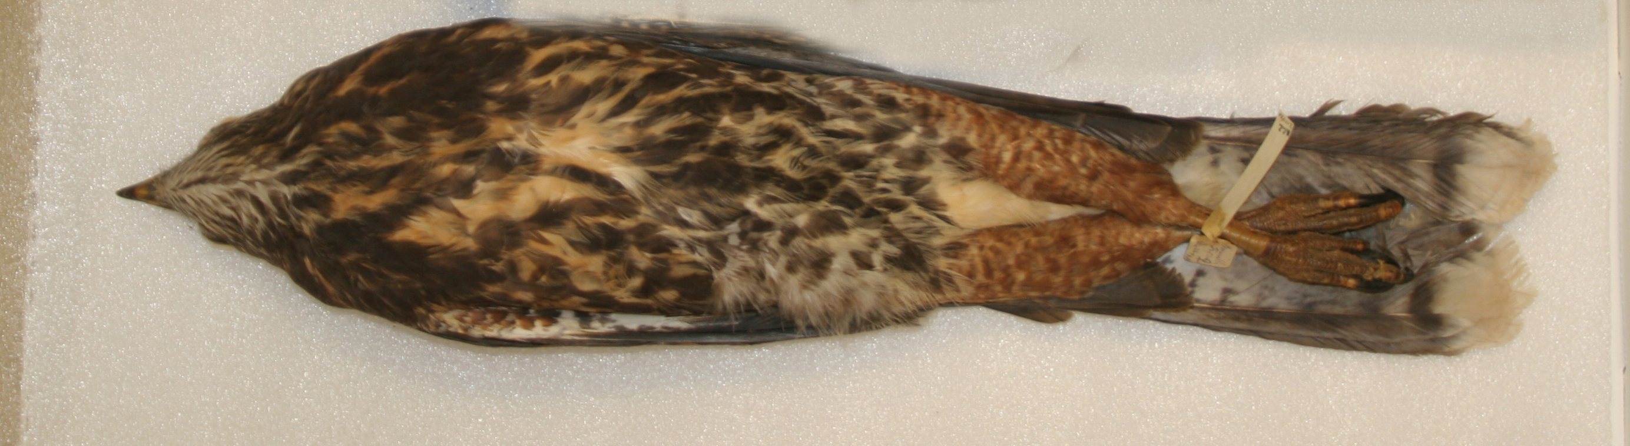
Juvenile plumages differ between the taxa even more than adults’.
Carnegie
BWH Underparts buffy with dark streaking.
HH Underparts dark with buffy markings.
Museum Comparative Zoology

Slide 10

Juvenile plumages differ between the taxa even more than adults’.
Carnegie
BWH Leg feathers buffy with faint rufous barring.
HH Leg feathers rufous with buffy barring.
Museum Comparative Zoology

Slide 11
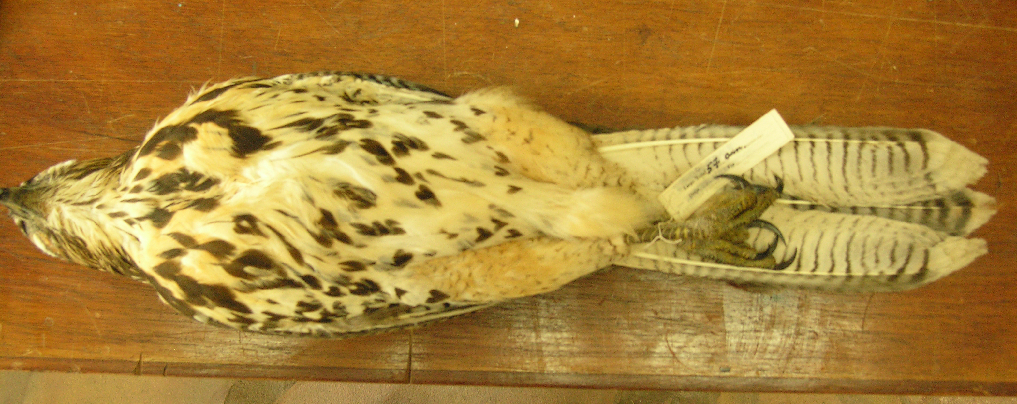
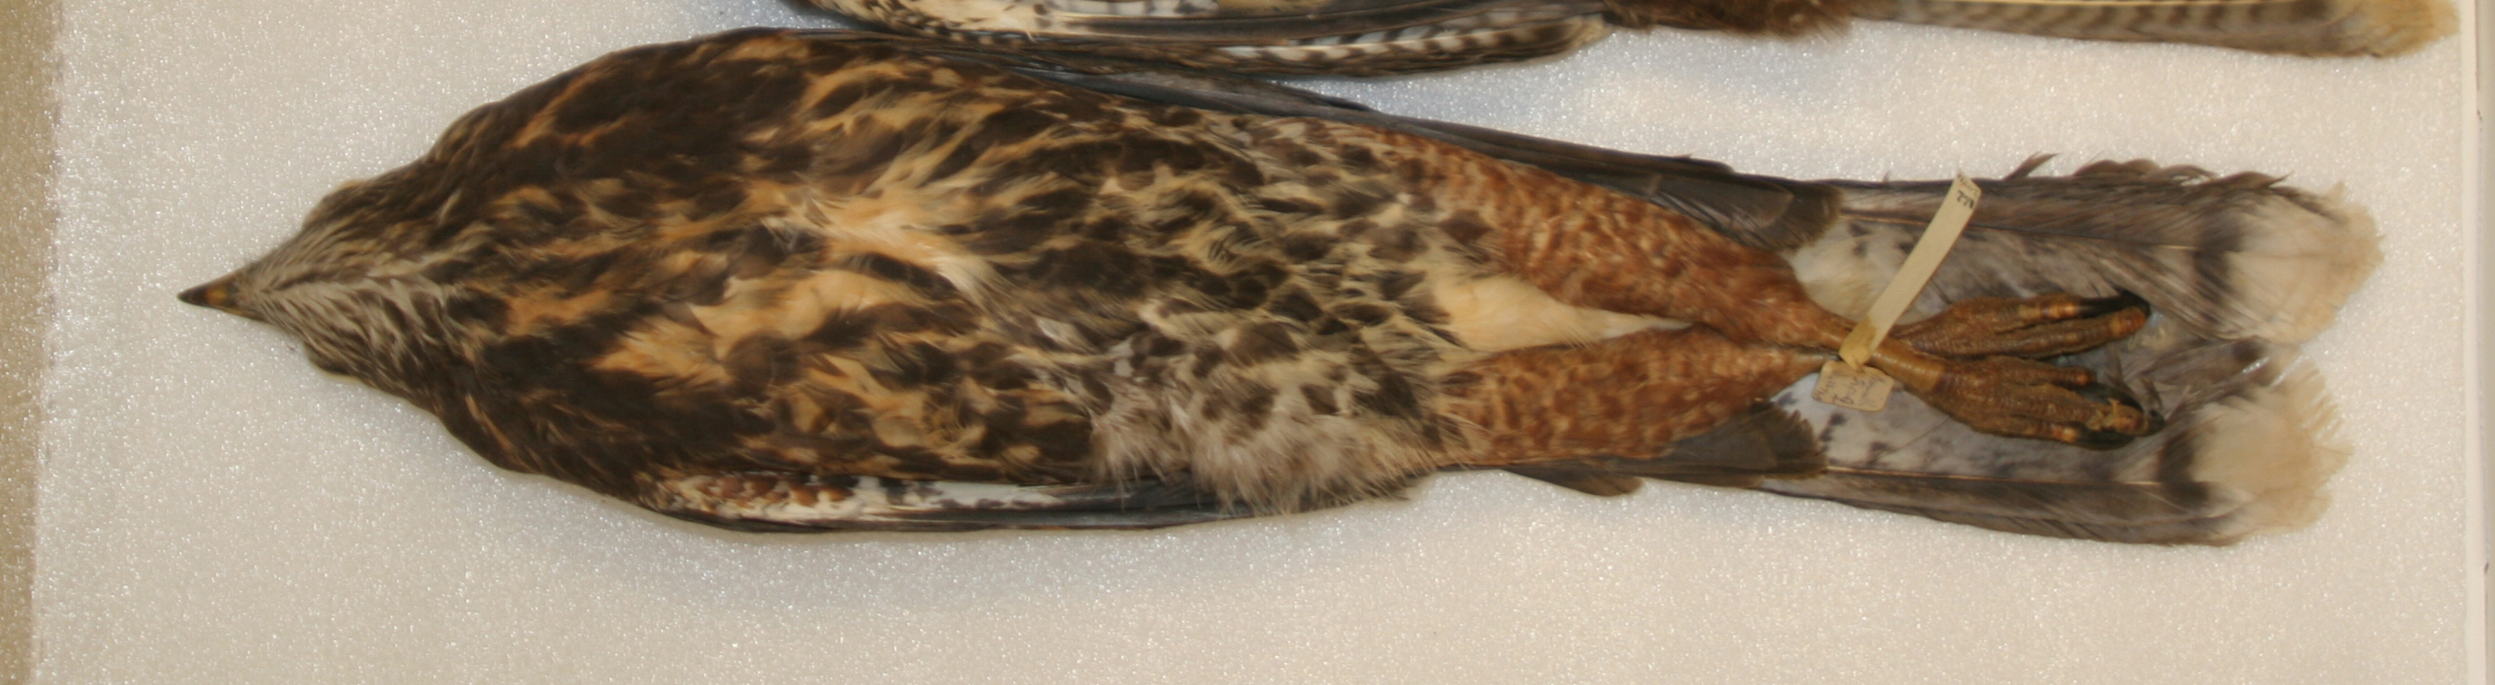
Juvenile plumages differ between the tax even more than adults’.
BWH Narrow dark bands on under tail.
El Bolson
HH Wider dark band on under tail.
Museum Comparative Zoology

Slide 12
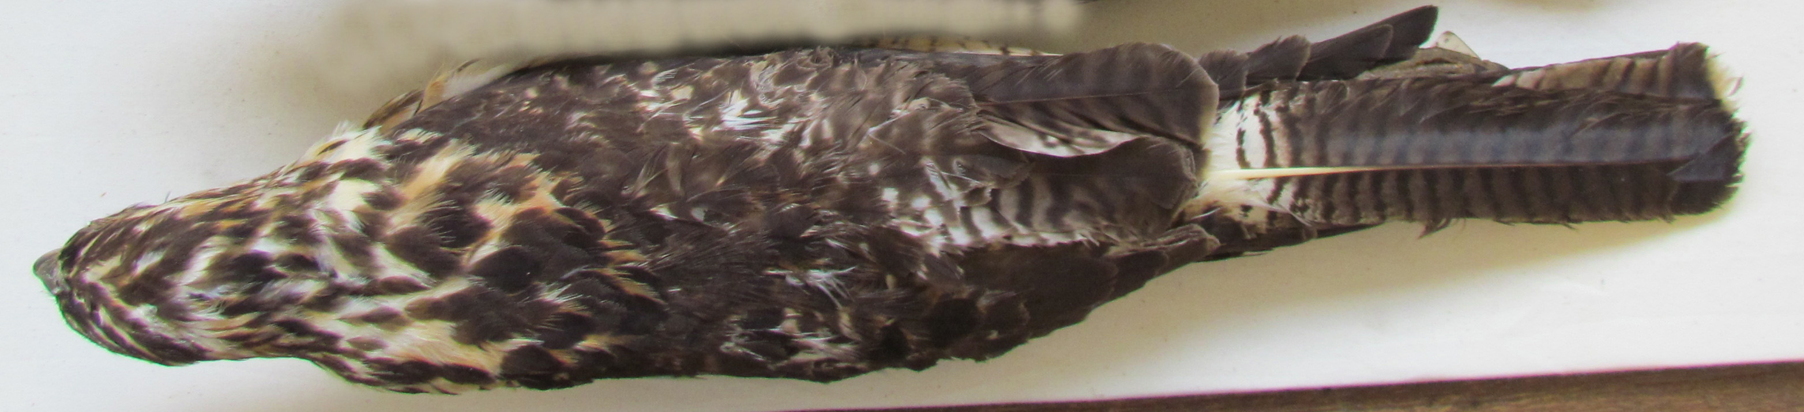
Juvenile plumages differ between the tax even more than adults’.
Carnegie
BWH Buffy markings on upperprts
Museum Comparative Zoology
HH Rufous not buffy markings on upperparts.

Slide 13
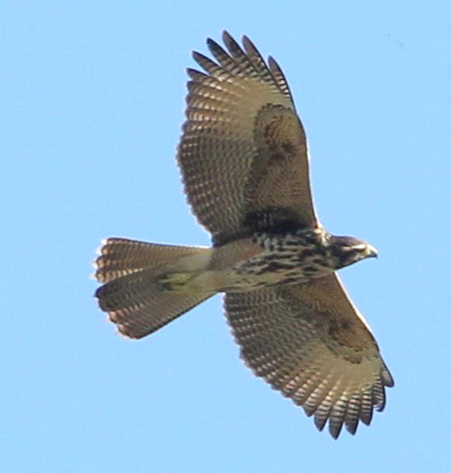
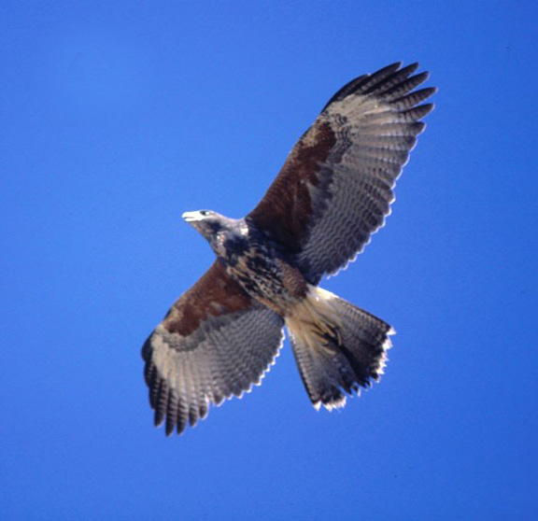
Juvenile plumages differ between the taxa even more than adults’.
Gustavo Sebastian Cabanne
BWH Buffy underwing coverts
HH Rufous underwing coverts

Slide 14
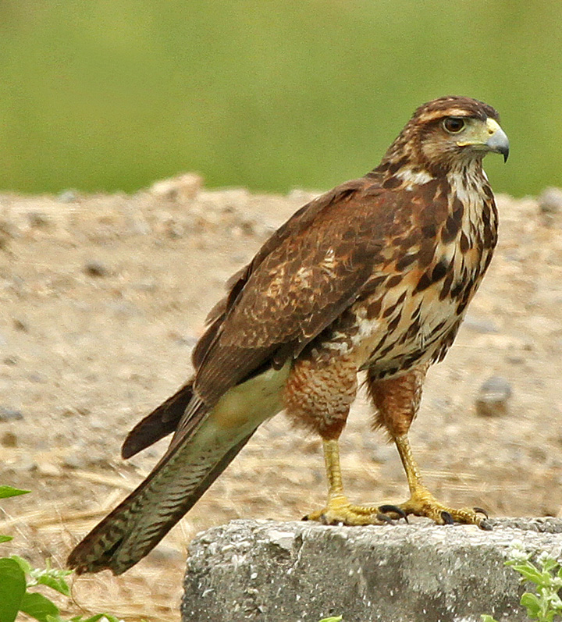
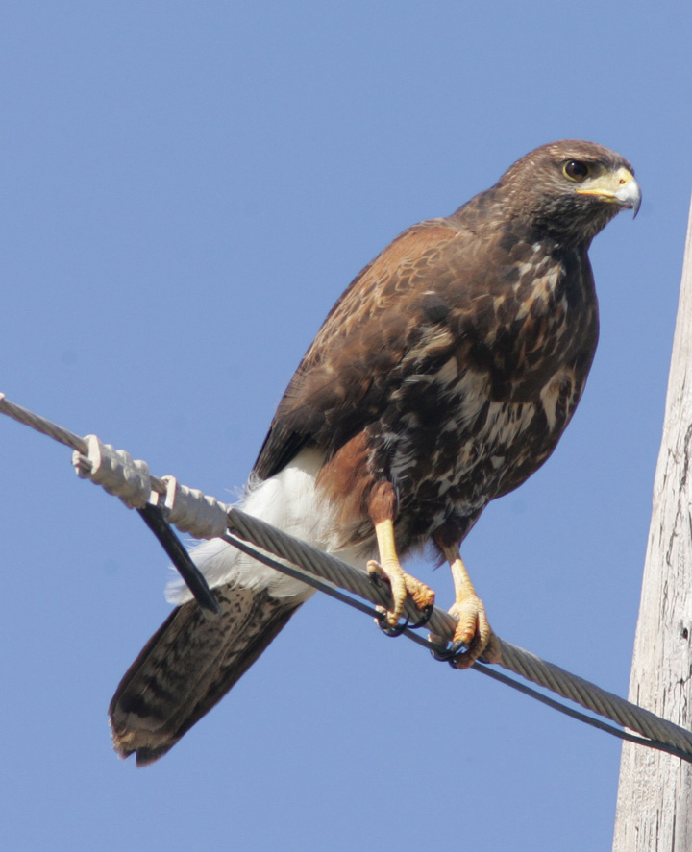
Juvenile plumages differ between the taxa even more than adults’.
Roger Ahlman
BWH
HH

Slide 15
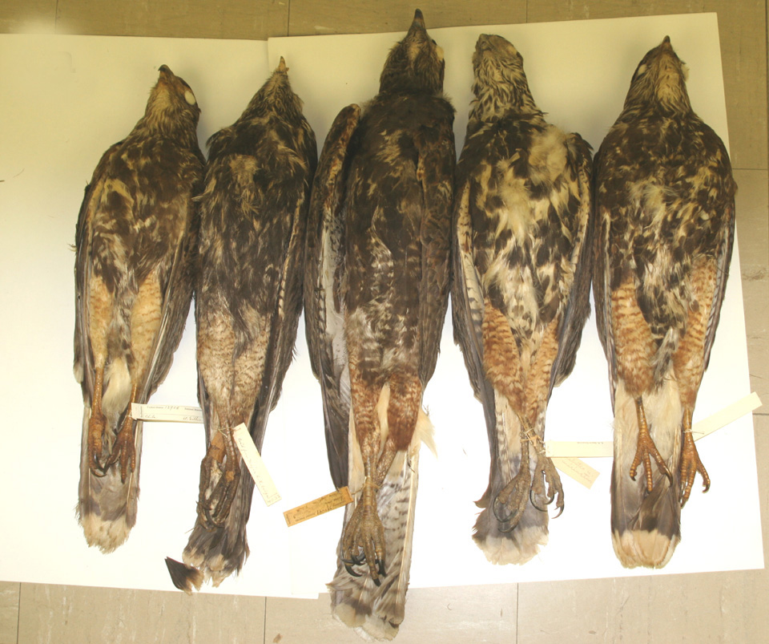
Harris’s Hawk molt directly from juvenile to adult plumage in the 2nd prebasic molt.
However, Bay-winged Hawks do not. They have two intermediate immature annual plumages between juvenile and adult plumages: Basic II and Basic III.
HH
BWH - Basic II specimens appear much like juvenile HHs. Differ in having flight feather molt.
BWHs
Museum Comparative Zoology
US National Museum

Slide 16
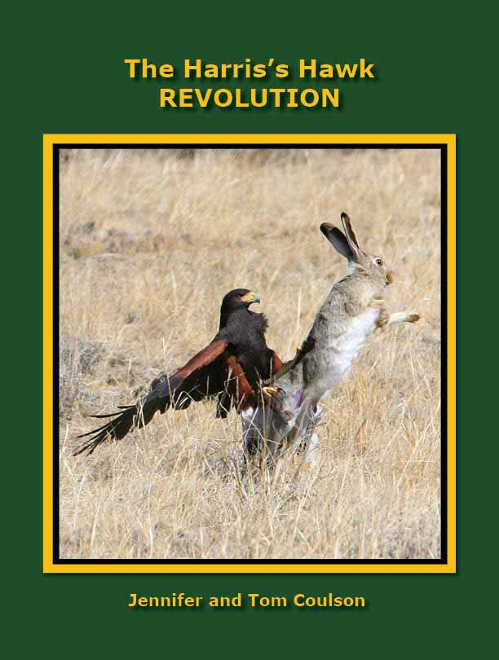
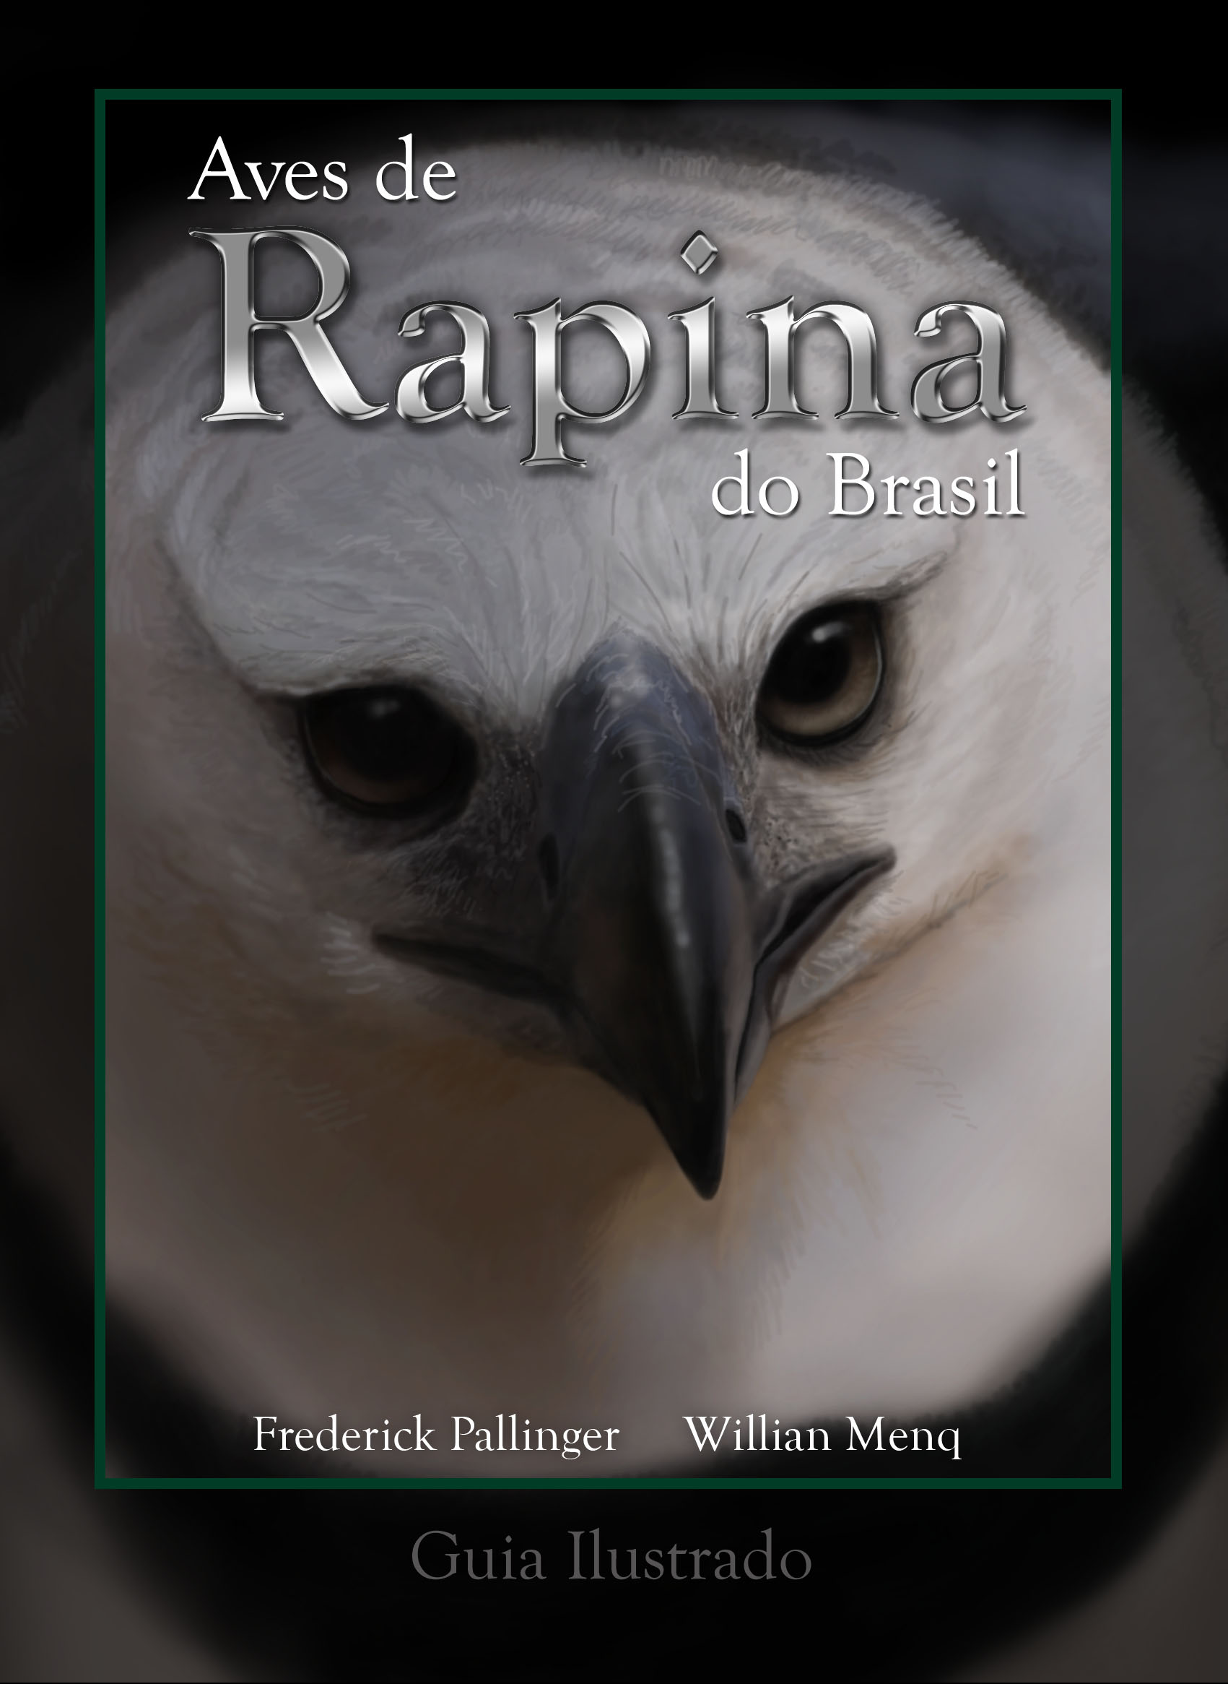
Only two published books mention these Basic II & III plumages: Coulson & Coulson (2012) and Pallinger & Menq (2022)
Neither describes them in detail.

Slide 17
Two Basic II Bay-winged Hawk photos taken in Brazil can be seen at:
https://www.wikiaves.com.br/4784500
https://www.wikiaves.com.br/692648
These photos are of Basic II BWHs in flight, showing remige molt and body plumage like juvenile Harris’s Hawk.
A photo of a Basic III BWH taken in Brazil can be seen at:
https://www.wikiaves.com.br/2906986
This photo of a Basic III shows two waves of remige molt and adult-like body.

Slide 18
The difference in number of years to attain adult plumage must have a genetic basis.
Should these taxa interbreed, how many immature plumages would such a hybrid have? One, two, or three.
There have been only two DNA analyses done comparing these taxa, both with a limited sample of DNA. Nevertheless, they do show a difference between them.

Slide 19
Two published DNA analyses:
Riesing et al. (2003) used 2 mitochondrial markers (nd6 gene and pseudo-control region (ΨCR) & sequenced 2 unicinctus specimens and one harrisi. Their ML tree shows the 2 BWH as sister to the HH.
Raposo do Amaral et al. (2009) sequenced the nuclear intron Fib5 for 3 specimens, one HH from Texas and 2 BWH from South America. As with the Riesing tree, the 2 BWH clustered together as sister taxa to HH.

Slide 20
We found no evidence of interbreeding between these taxa, including no specimens or photographs that show traits of both..
This is to be expected, as their ranges are allopatric.

Slide 21
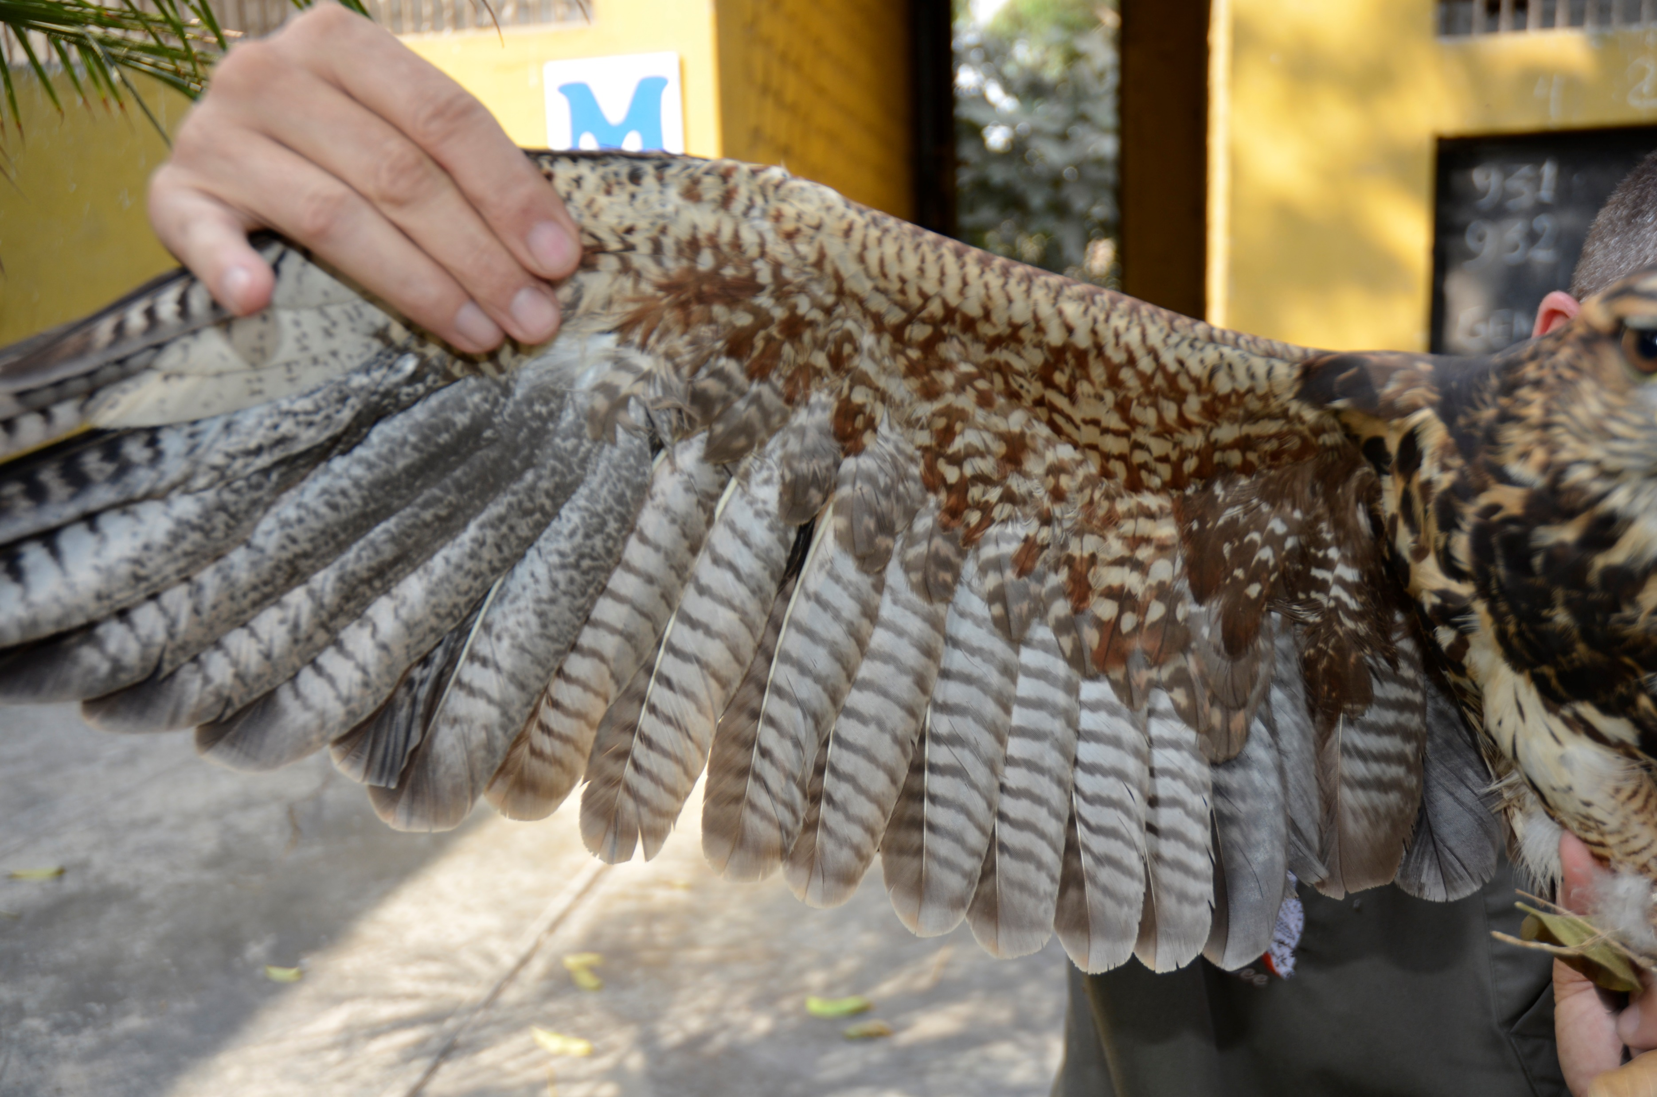
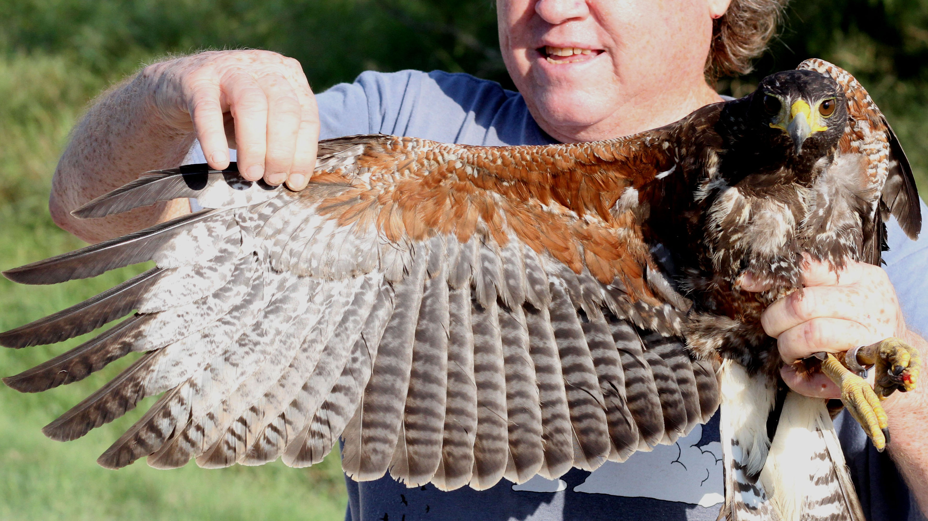

Basic II BWHs appear almost like juvenile HHs, but show one cycle of flight feather molt.
BWH has new inner primaries & a secondary.
HH shows no primary or secondary molt.
Lee Jones

Slide 22
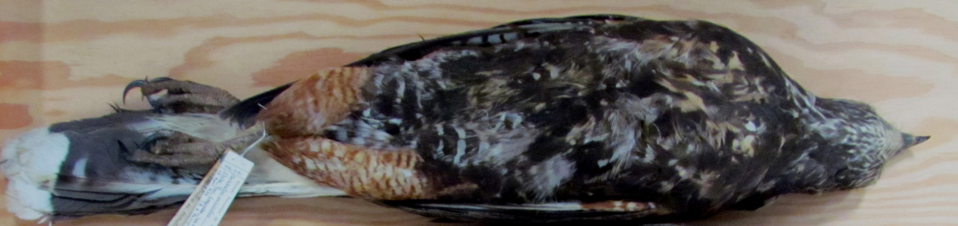
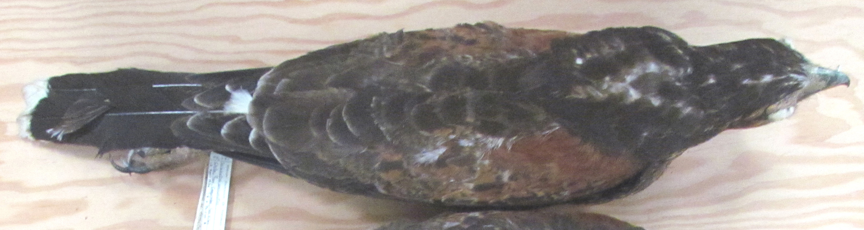
Basic III BWHs are more adult-like and show two cycles of remige molt.

Slide 23
Some references cite records of Harris’s Hawk in South America, but we found no harrisi specimens collected in South America in museums.
Researchers from North America have not seen any Harris’s Hawks in Ecuador.
Most likely, sightings of Basic II or Basic III BWHs were mis-identified as juvenile HHs.

Slide 24
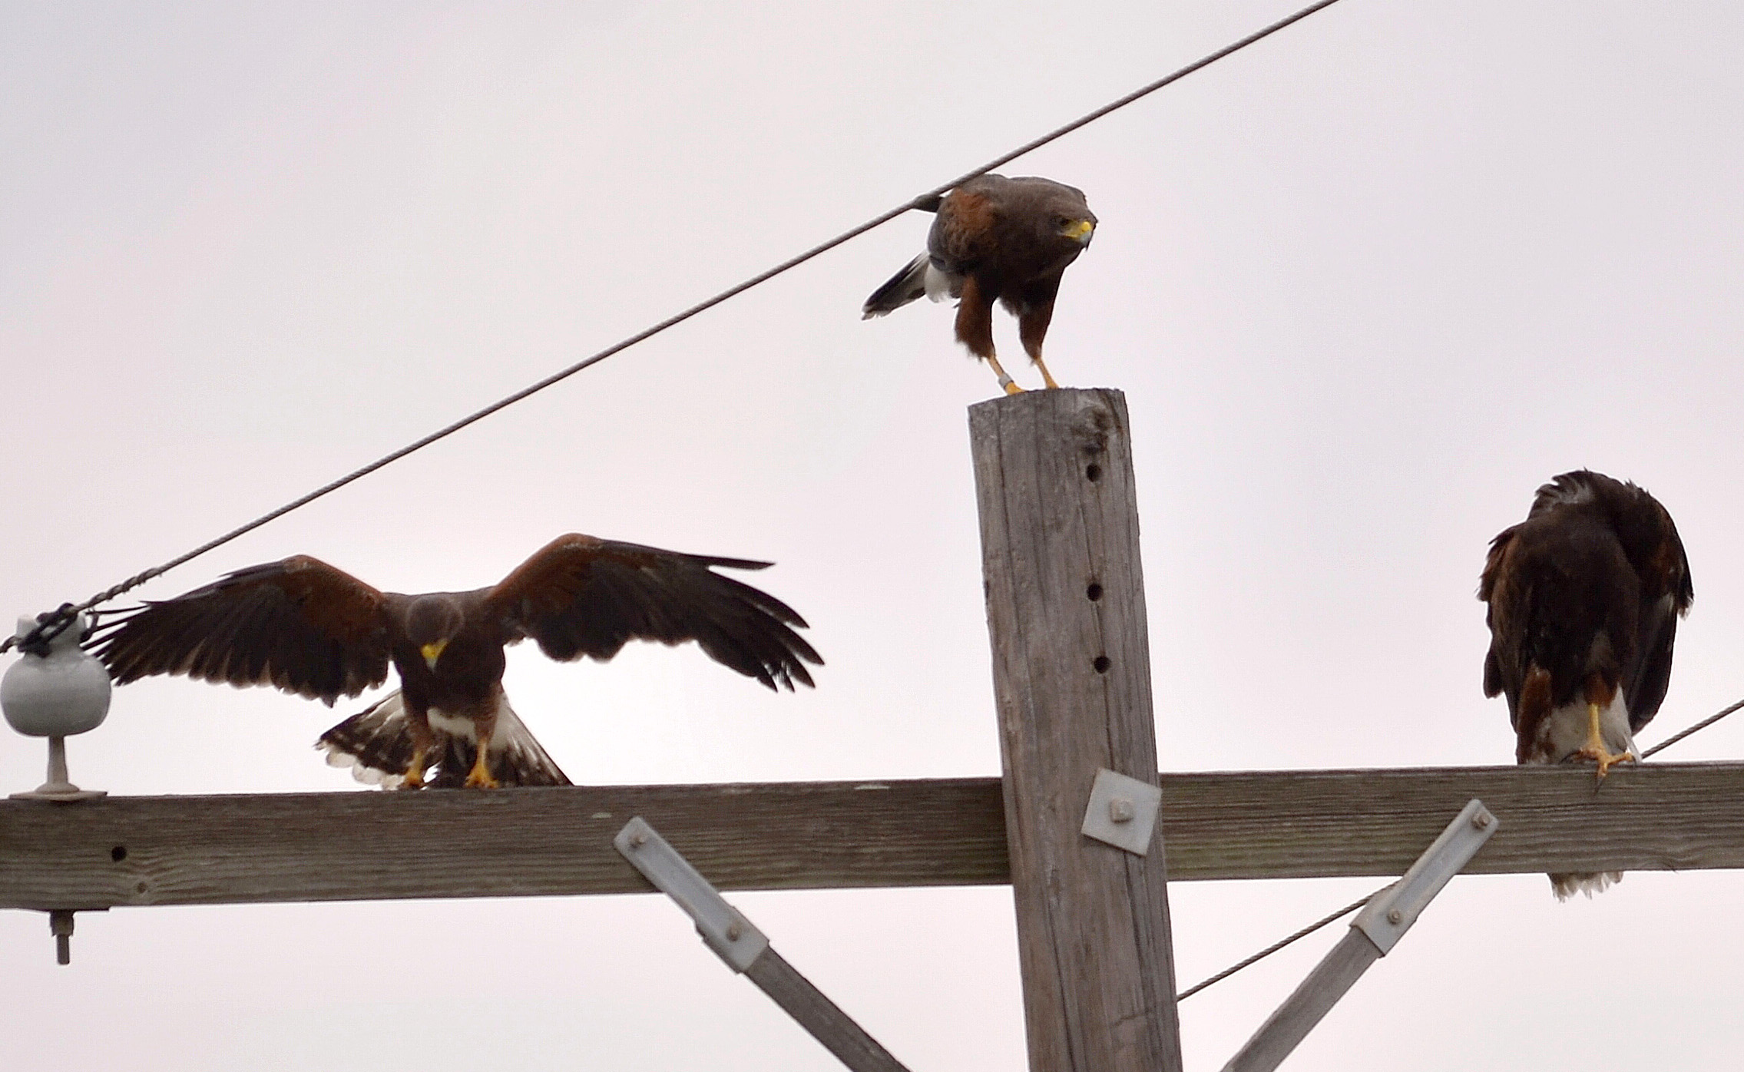
Behavioral differences between the taxa are cooperative hunting and breeding that is reported regularly for Harris’s Hawk but is rare or absent in Bay-winged Hawk.
HH: Often seen in territory as a trios, or more.
BWH: Almost always as pairs.
HHs

Slide 25
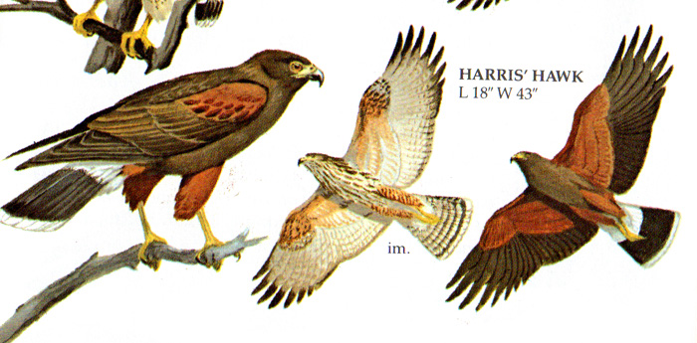
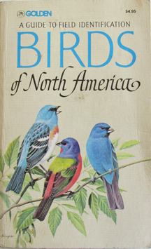
Assumptions that these two are the same species has negatively affected their illustration in field guides.
Golden Guide (N. America) shows juvenile Bay-winged Hawk instead of Harris’s Hawk. All other NA guides are accurate.

Slide 26
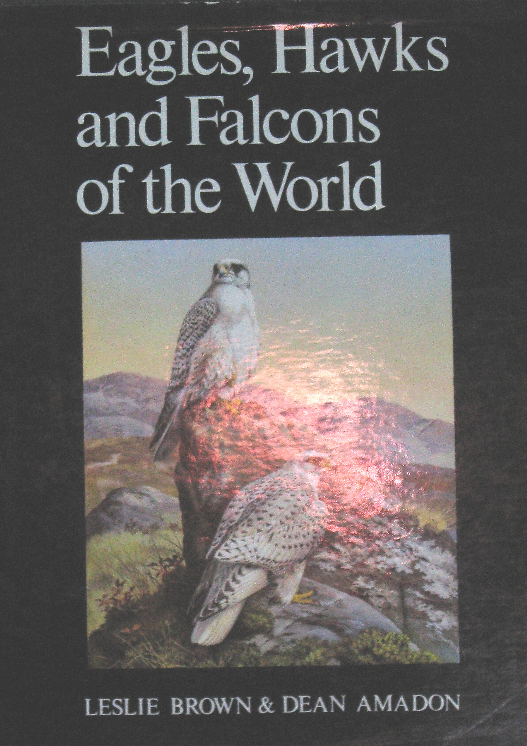
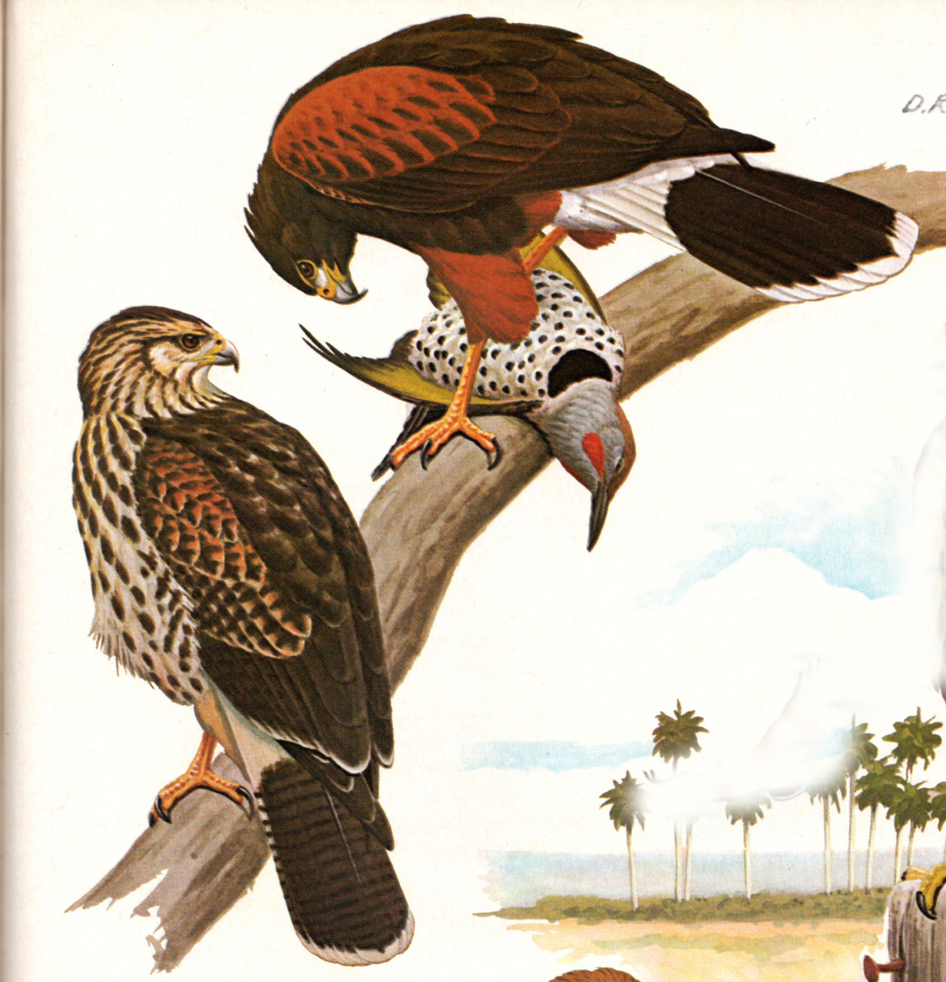
Brown & Amadon shows adult Harris’s Hawk and juvenile Bay-winged Hawk, without labeling them as such.

Slide 27
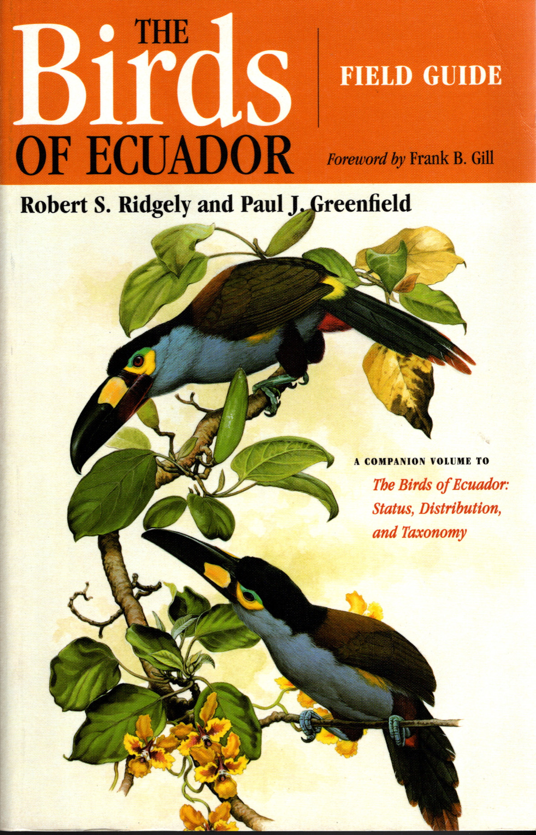
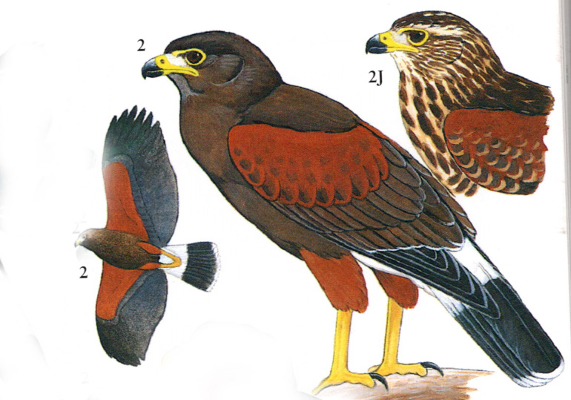
Ridgly & Greenfield shows Harris’s Hawk instead of Bay-winged Hawk for Peru guide.

Slide 28
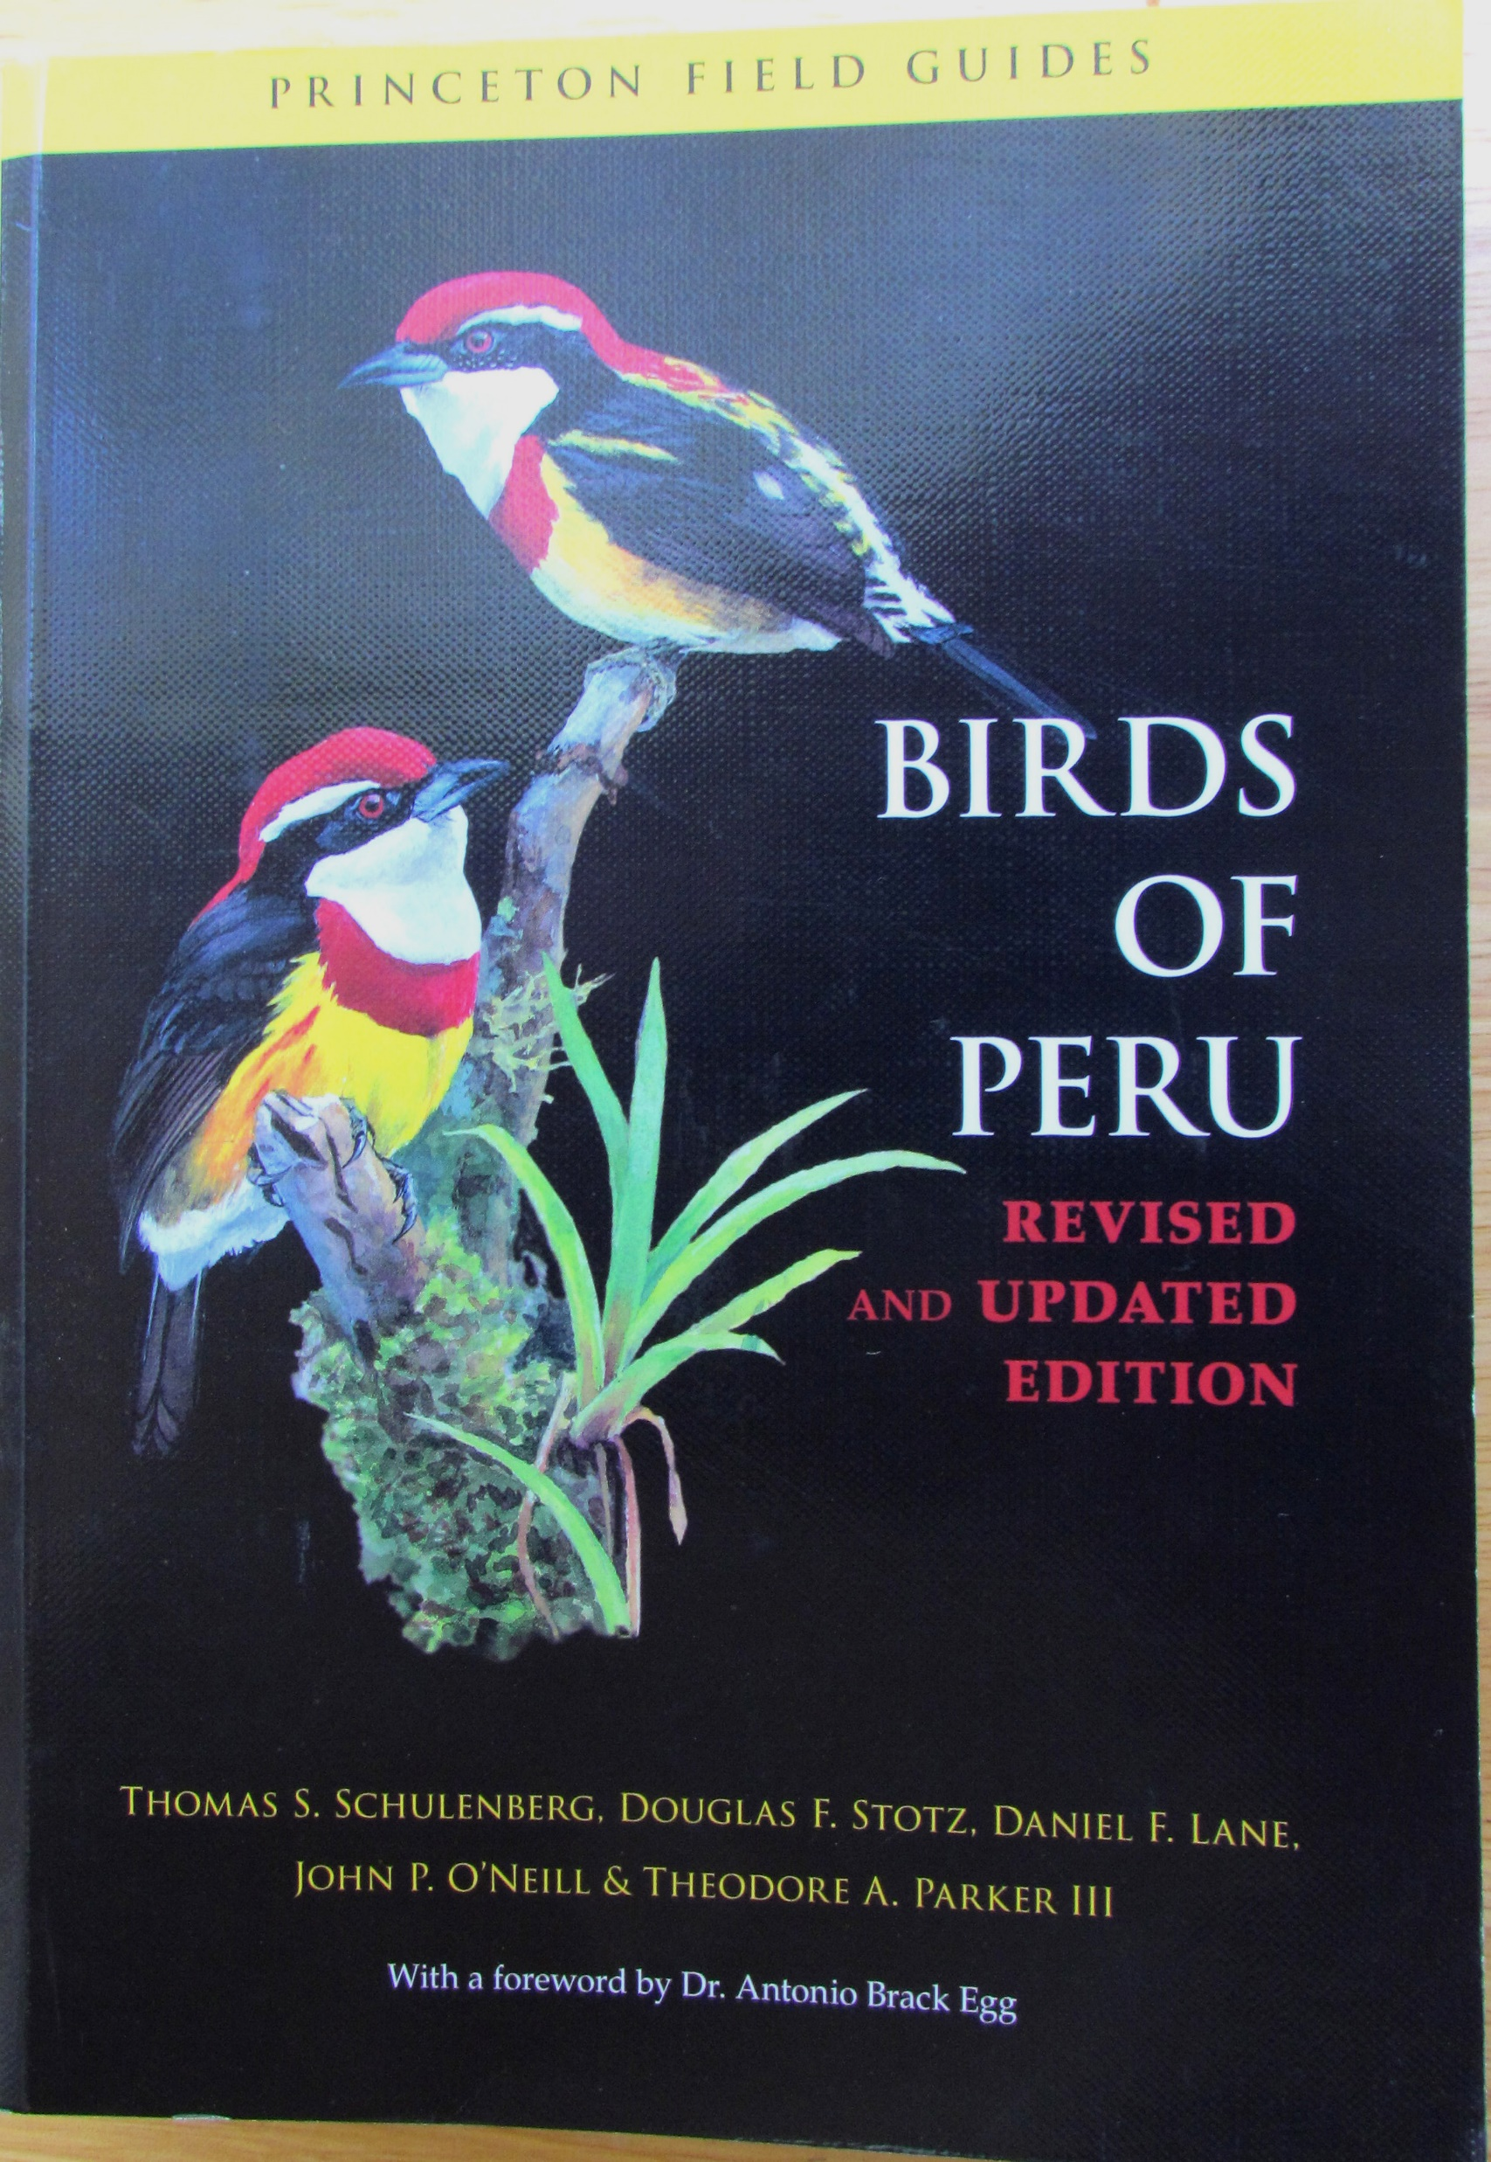
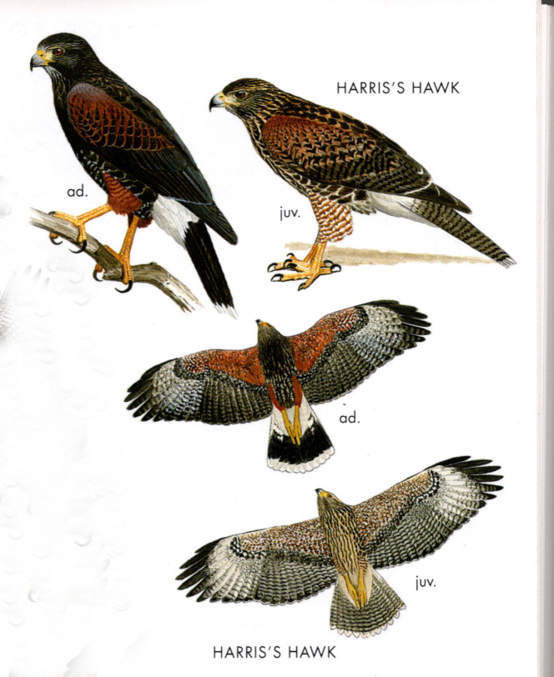
Scheulenburg et al. shows adult and juvenile Bay-winged Hawk correctly but do not show nor mention Basic II & II plumages.

Slide 29
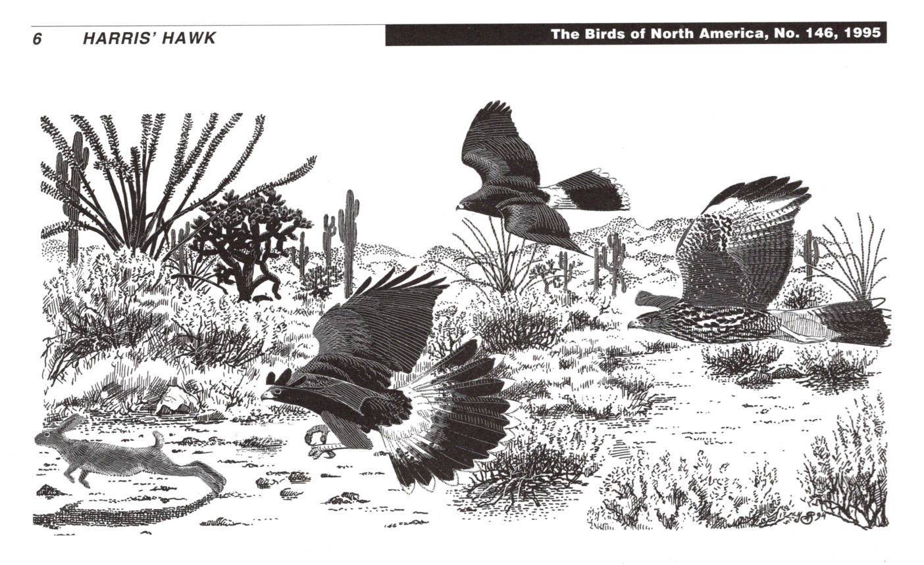
It is not clear that the differences between these taxa in the extent of cooperative hunting and breeding has taxonomic value or not.

Slide 30
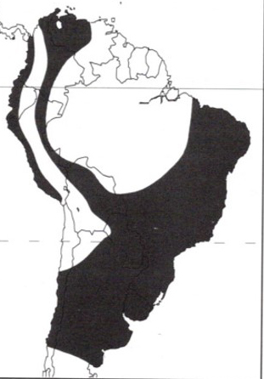
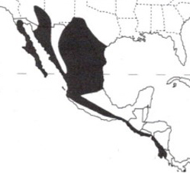
Ranges: Allopatric
HH: North & Central America
BWH: South America
The Biological Species Concept does not address allopatric taxa.

Slide 31
Sangster (2018) described species as population lineages with these tenets:
Any type of data is potentially relevant to species determination or not.
Different types of data are relevant.
Taxonomists should use many types of data.
Data should be integrated.
Evaluations should be revisited when new data are available.

Slide 32
In Summary:
BWHs and HHs are diagnosably different in adult and juvenile plumages.
Further, BWH has two intermediate immature plumages. No raptor species has forms that differ in the number of age-related annual plumages.
The above suggest that HH and BWH are separate evolutionary lineages.

Slide 33
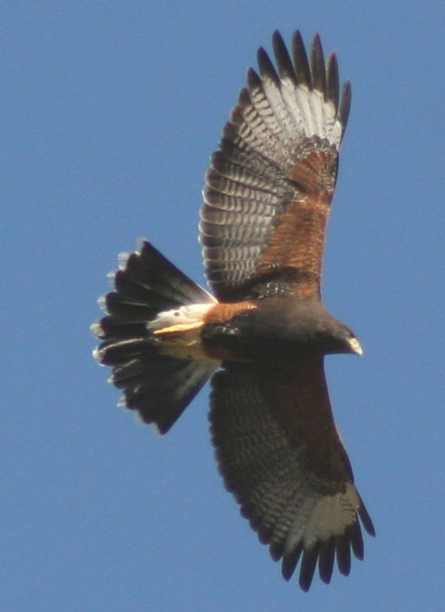
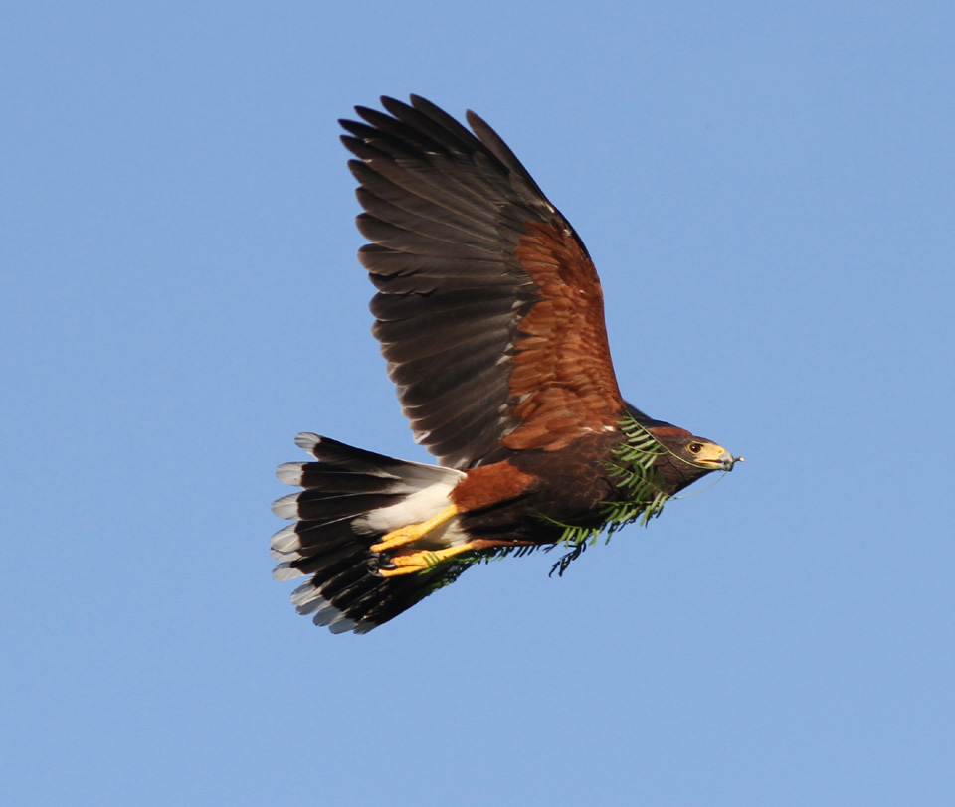
Our conclusion: Bay-winged Hawk and Harris’s Hawk are closely related but separate species!
Thanks for your attention
Any questions?

