Slide 1
Science Olympiad Photo Quiz 1
First, you’ll see a photo showing just enough to allow you to clinch the ID. Then, you’ll see the full photo with the name and perhaps some ID tips on specimens (not field ID)

Slide 2
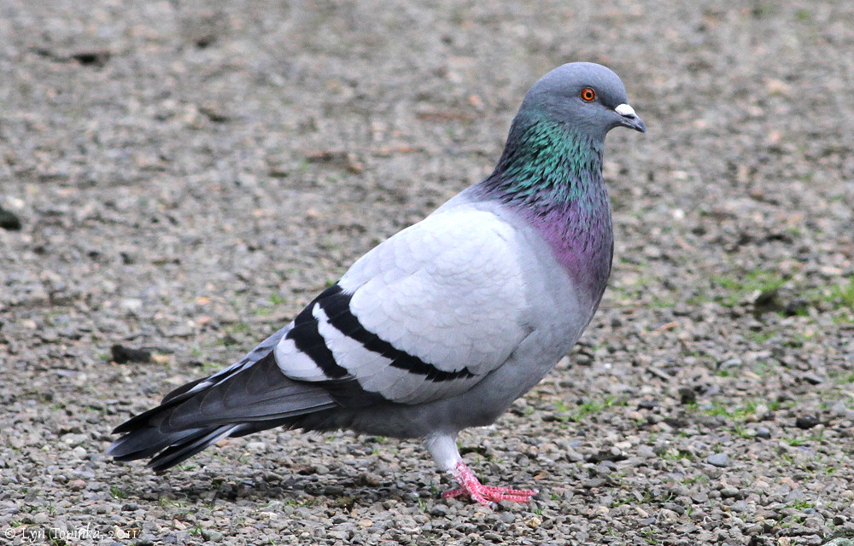

Slide 3
Notes:
Rock Pigeon, Columbidae, Columbiformes

Slide 4
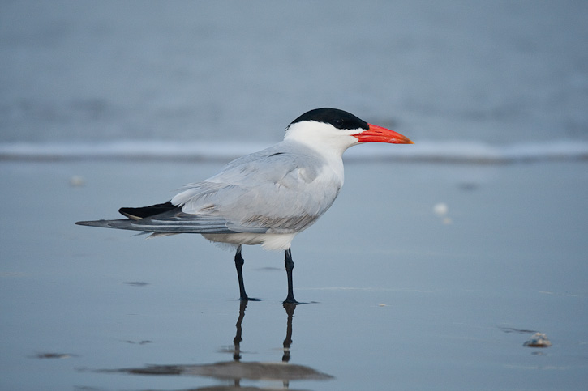

Slide 5
Notes:
Caspian Tern, Laridae, Charadriiformes. Obviously a tern, and with a large, thick, unicolored bill. Royal Tern would be similar but bill slimmer (hard to judge without direct comparison), paler primaries, and deeply forked tail.

Slide 6
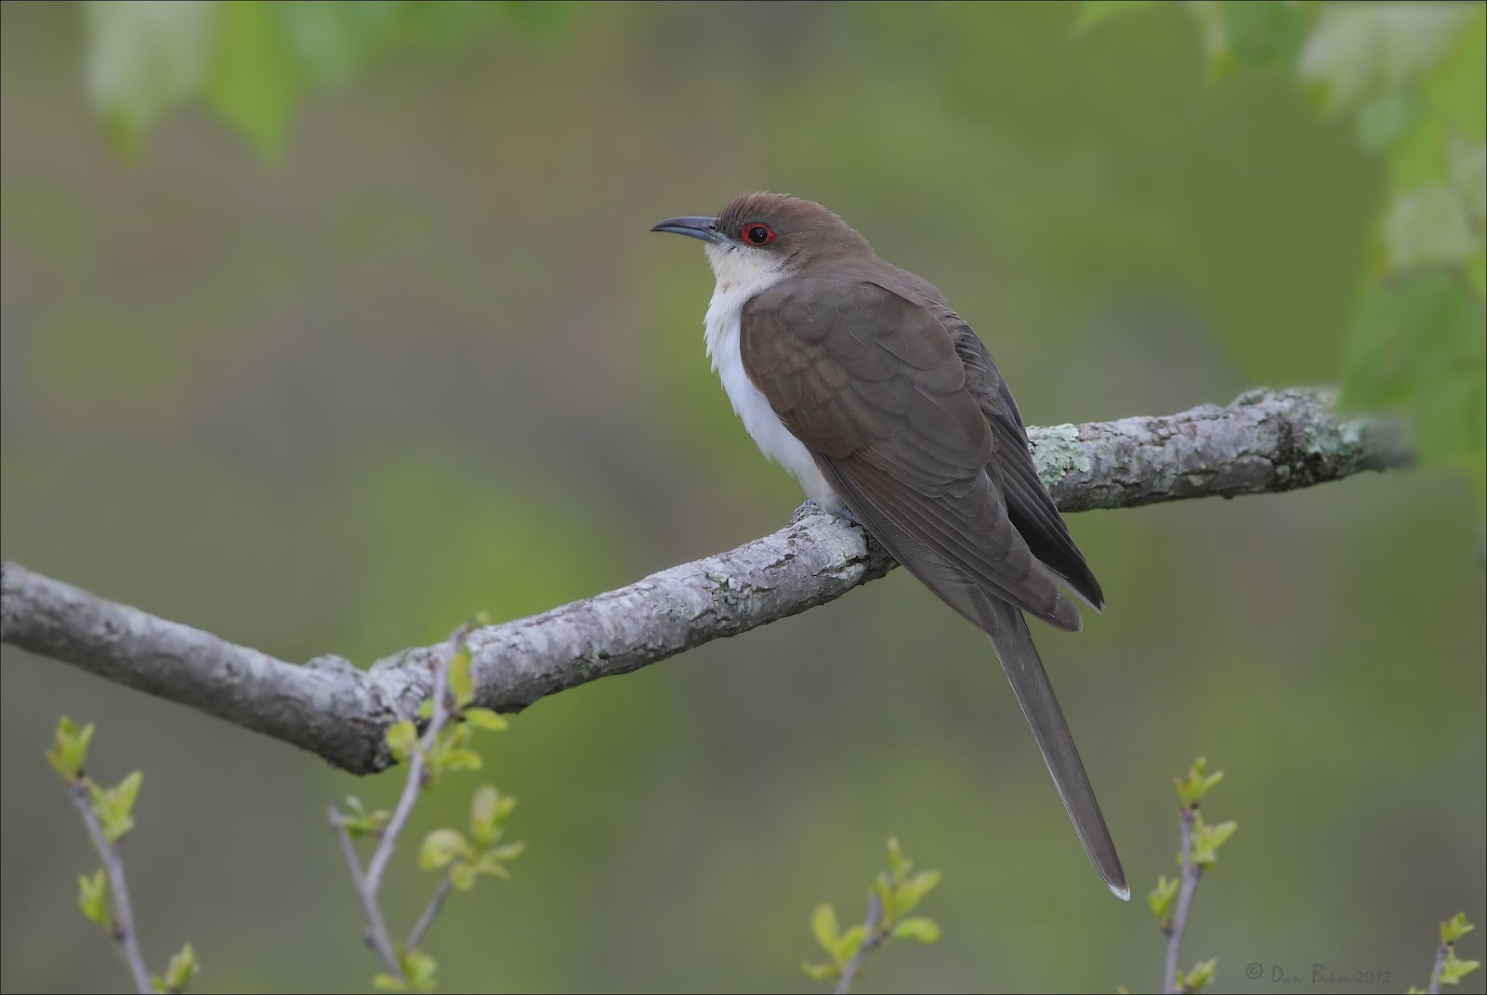

Slide 7
Notes:
Black-billed Cuckoo, Cuculidae, Cuculiformes: all you need to do is

Slide 8
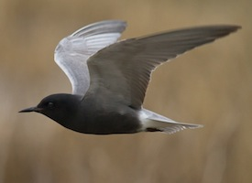

Slide 9
Notes:
Black Tern, Laridae, Charadriiformes. Only black-headed bird with dagger-shaped bill.

Slide 10
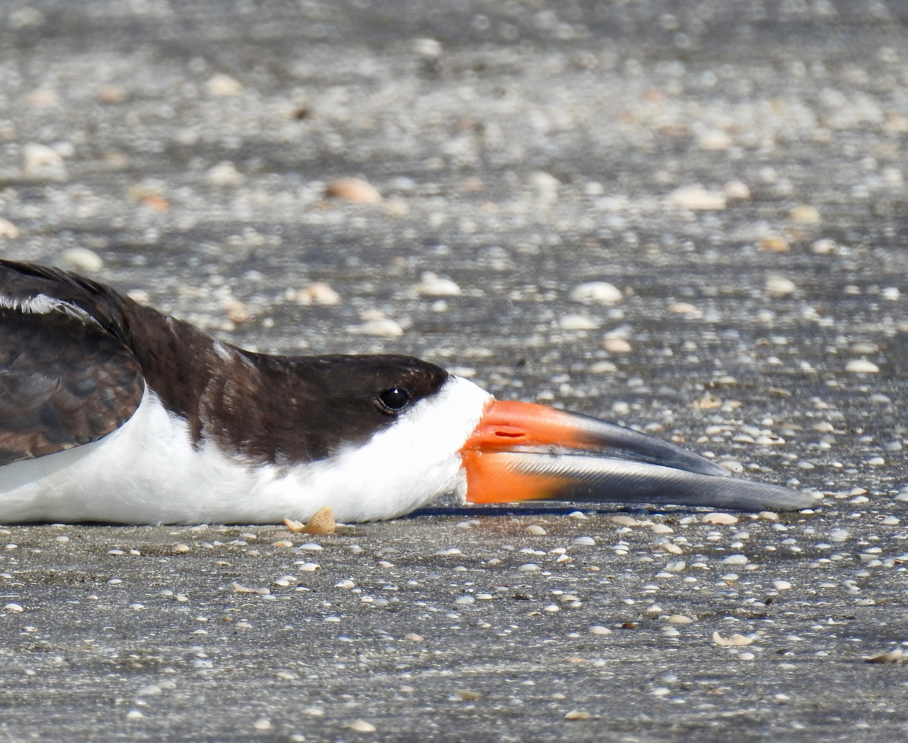

Slide 11
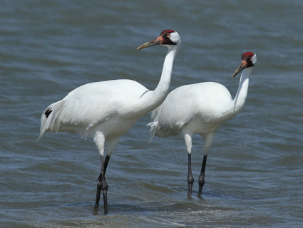

Slide 13
If you could see the bill close up, the way you can in lab, you would be able to see that the nostrils are open holes (“perforate” is the technical term), unlike anything in Ardeidae or Threskiornithidae
Whooping Crane; Gruidae; Gruiformes

Slide 14
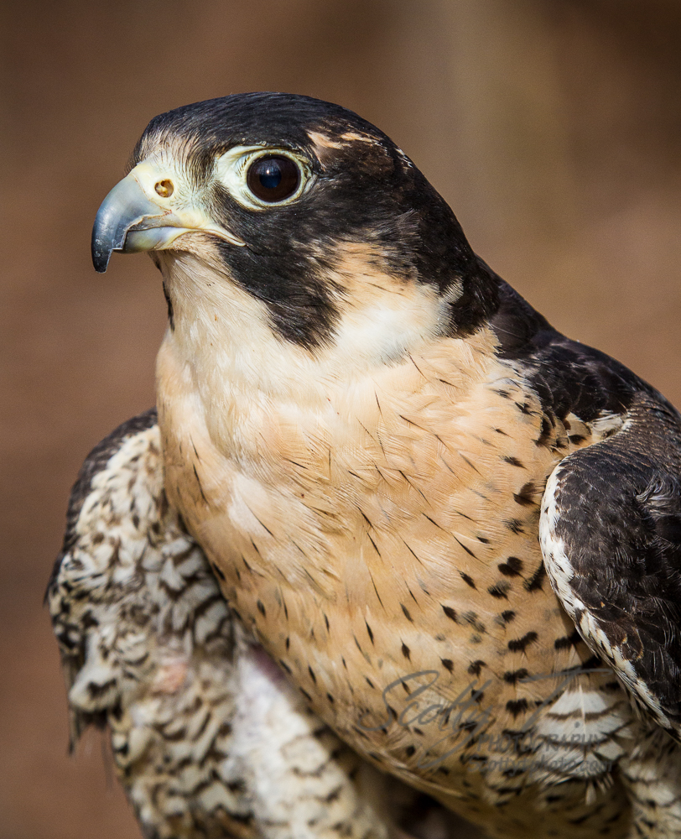

Slide 16
Dark “sideburn” mark in face. Note, by the way, that you can even see the bony tubercle in the nostril that clinches this as Falconidae
Peregrine
Falcon; Falconidae; Falconiformes

Slide 17
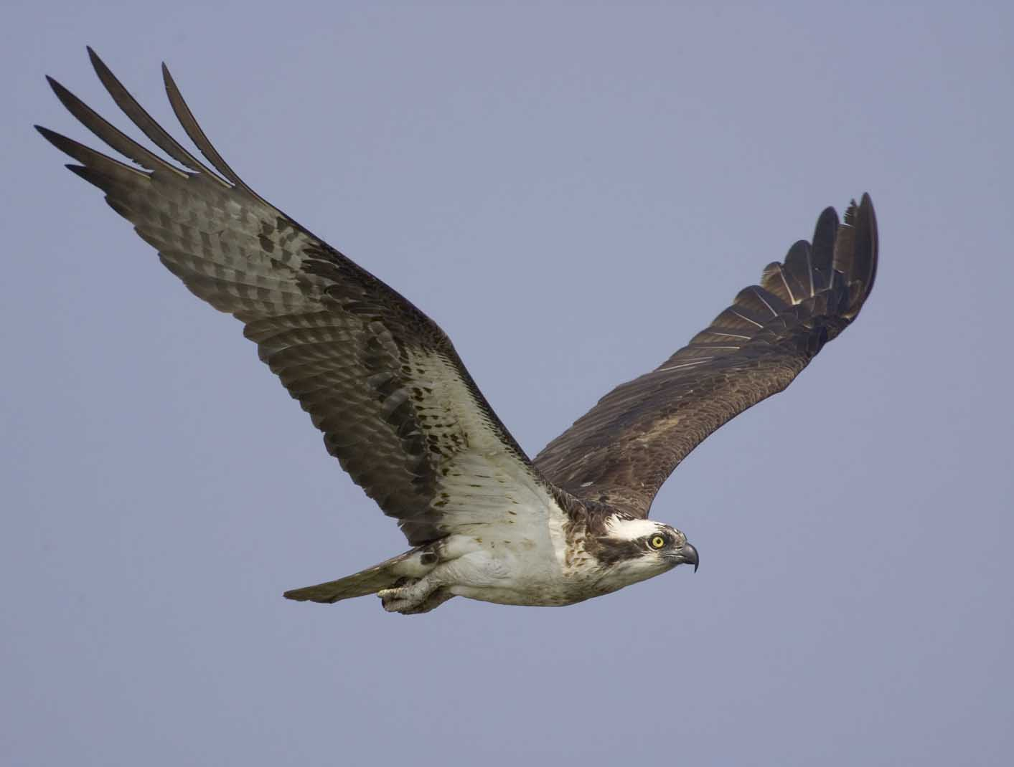

Slide 19
Nothing else has that white crown and dark face
And if you could feel the underside of the toes, you would feel the spiny spicules that aid in holding slippery fish
Osprey; Pandionidae; Accipitriformes

Slide 20
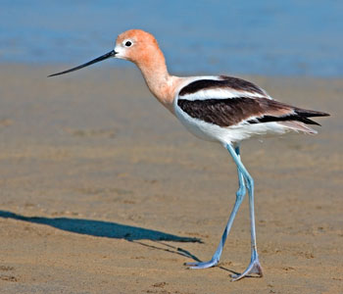

Slide 22
American Avocet; Recurvirostridae; Charadriiformes

Slide 23
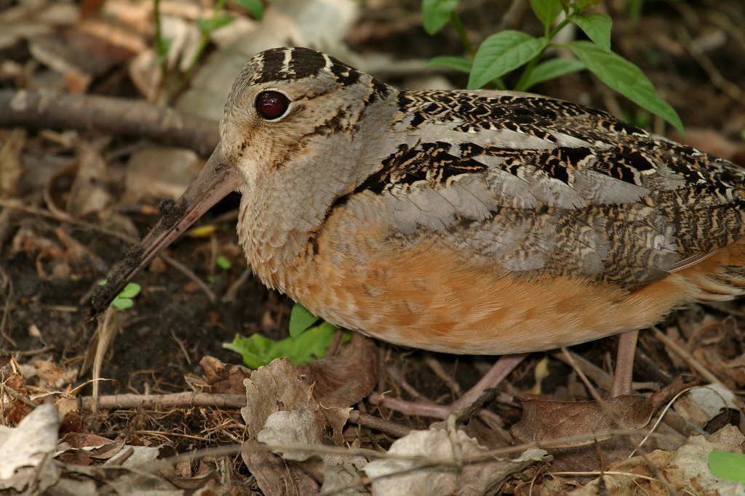

Slide 25
Stripes on crown perpendicular to body axis; short legs, rufous belly. Note, by the way, the big eyes = nocturnal
American Woodcock; Scolopacidae; Charadriiformes

Slide 26
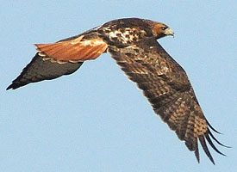

Slide 28
That bright orange-brown tail with narrow brownish band at tip is diagnostic.
Red-tailed Hawk; Accipitridae; Accipitriformes

Slide 29
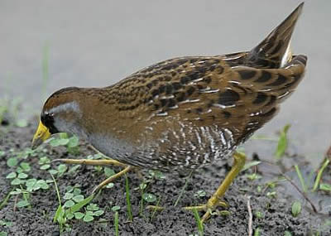

Slide 31
Distinctive face pattern; bill shape like a gallinule or coot
Sora; Rallidae; Gruiformes

Slide 32
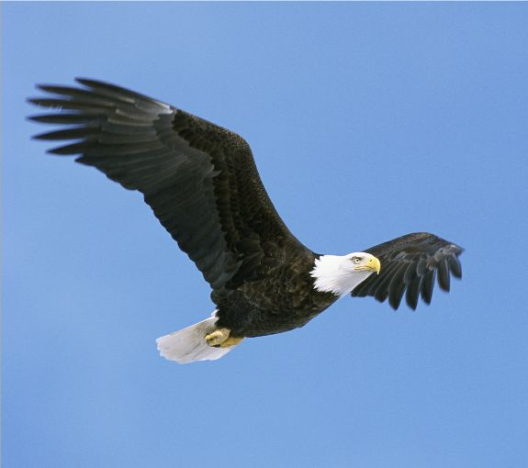

Slide 34
Any other birds with all-white tails and big feet?
Bald Eagle; Accipitridae; Accipitriformes

Slide 35
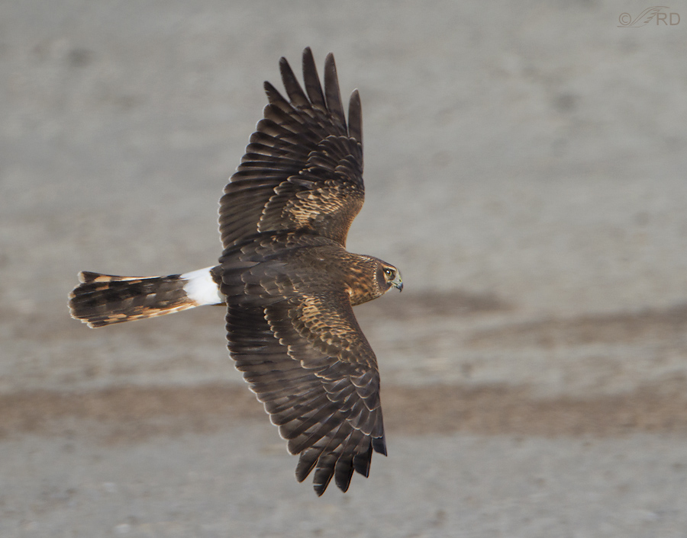

Slide 37
White uppertail coverts on tail with dull banding is diagnostic. Beware that rest of plumage highly variable due to age and sex differences
Northern Harrier; Accipitridae; Accipitriformes

Slide 38
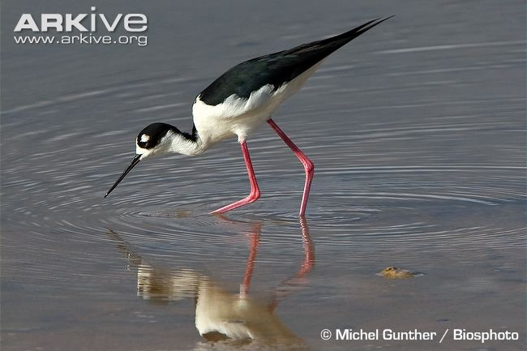

Slide 40
Black-necked Stilt; Recurvirostridae; Charadriiformes

Slide 41
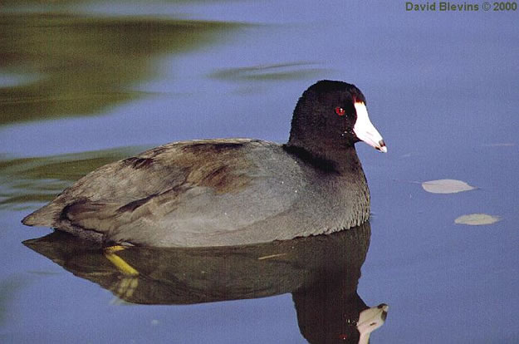

Slide 43
Only species with mostly pale bill rising high on forehead
American Coot; Rallidae; Gruiformes

Slide 44
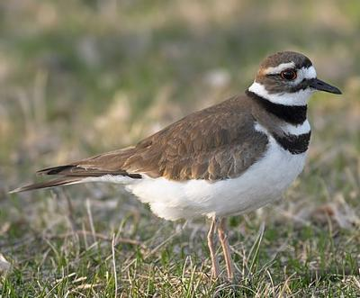

Slide 46
Two breast bands …
Killdeer; Charadriidae; Charadriiformes

Slide 47
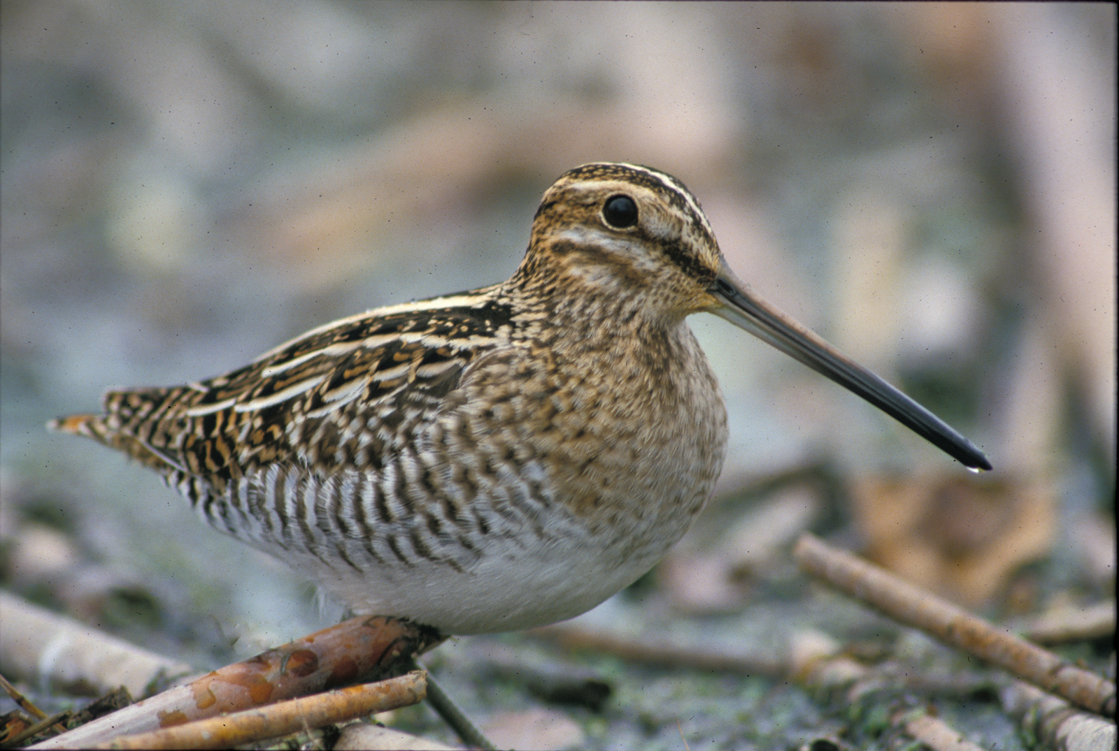

Slide 49
Conspicuous head and back stripes; extremely long bill; strongly banded sides and flanks
Wilson’s Snipe; Scolopacidae; Charadriiformes

Slide 50
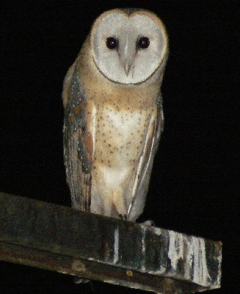

Slide 51
Notes:
Barn Owl, Tytonidae, Strigiformes. Anything else with that pale breast with dark spots?

Slide 53
Notes:
Black Skimmer, Rynchopidae, Charadriiformes. Only bird with longer lower mandible than upper.

Slide 54
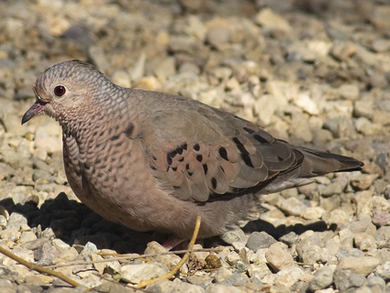

Slide 55
Notes:
Common Ground Dove, Columbidae, Columbiformes. Scalloped pattern on neck and nape; lacks bars on back of Inca Dove. No prominent dark marks in face like White-winged or Mourning, but in the hand, the dramatically smaller size should keep you away from anything but Inca Dove.

Slide 56
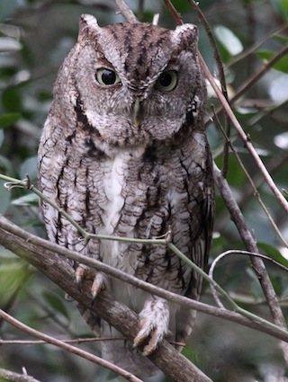

Slide 57
Notes:
Eastern Screech-Owl, Strigidae, Strigiformes. Note the unique pattern of markings on the underparts. Caution: the head tufts are typically flattened against the head in study skins.

Slide 58
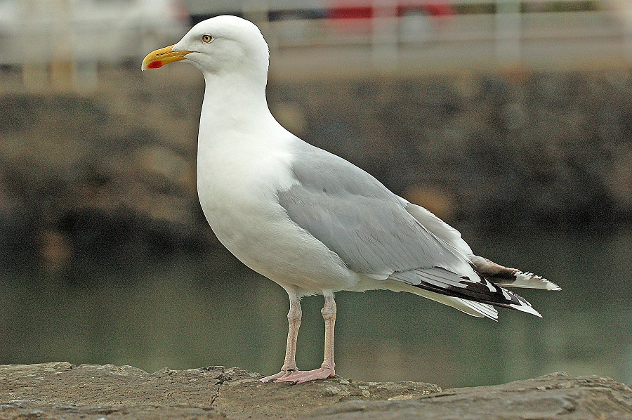

Slide 59
Notes:
Herring Gull (adult), Laridae, Charadriiformes. Gull-shaped bill with red spot mostly on lower mandible = Herring. Caution: the red color typically fades badly in specimens, but the location of the spot still diagnostic.

Slide 60
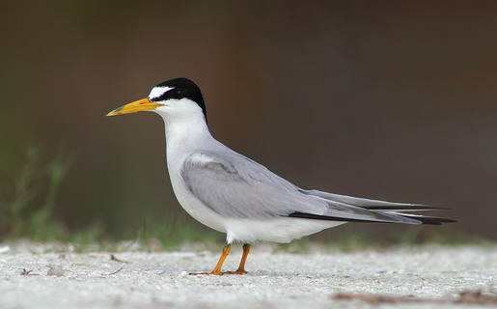

Slide 61
Notes:
Least Tern, Laridae, Charadriiformes: Only tern with white forehead and dark line through lores. Very small.

Slide 62
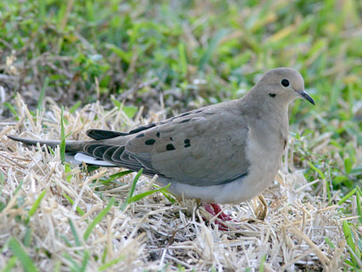

Slide 63
Notes:
Mourning Dove, Columbidae, Columbiformes: black spot in lower face, no white wing patch, no collar on nape.

Slide 64
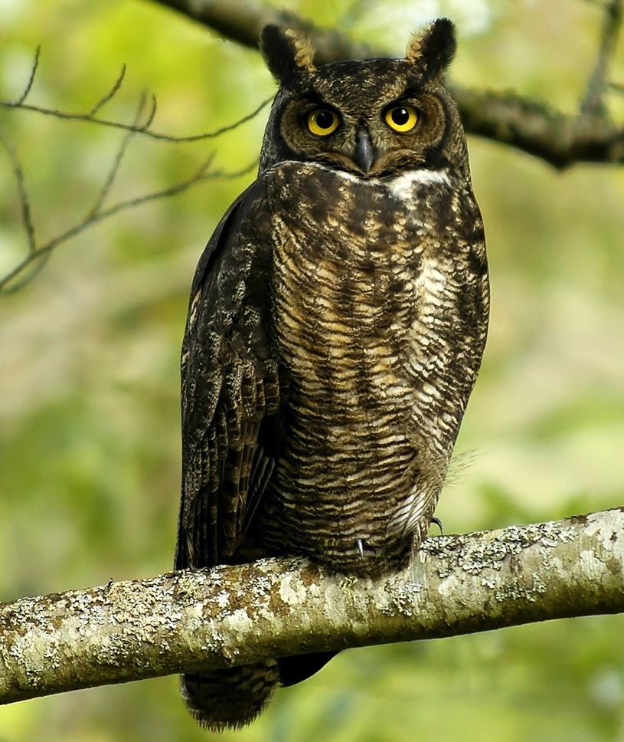

Slide 65
Notes:
Great Horned Owl, Strigidae, Strigiformes. Distinctive pattern on breast, typically with narrow white extreme upper breast/neck.

Slide 66
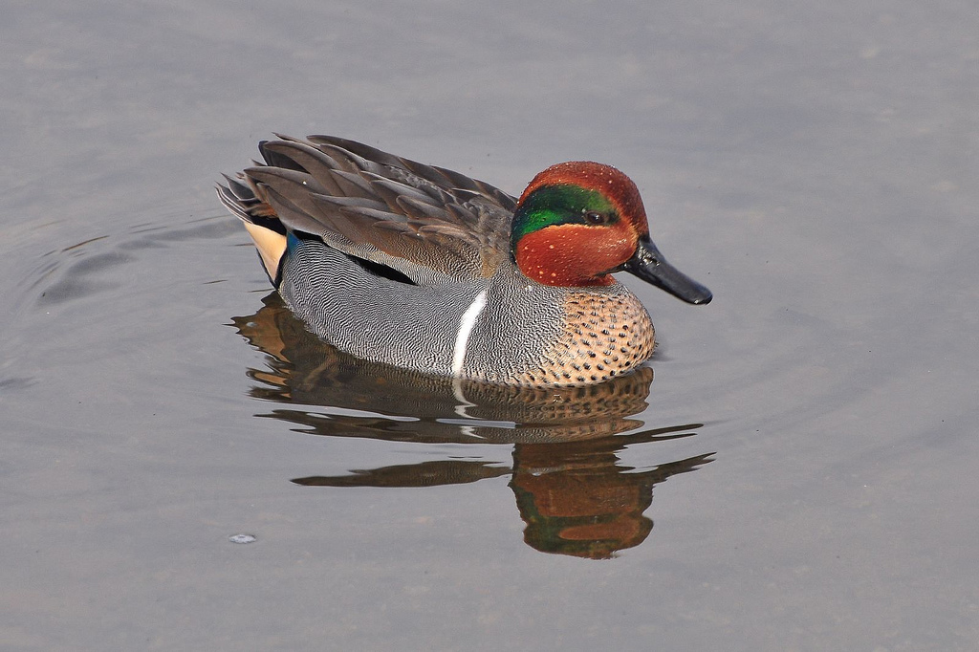

Slide 67
Green-winged Teal;
Anatidae; Anseriformes
Green face patch on reddish-chestnut head unique. Warning = that white mark on the sides of the breast sometimes hard to see in study skins

Slide 68
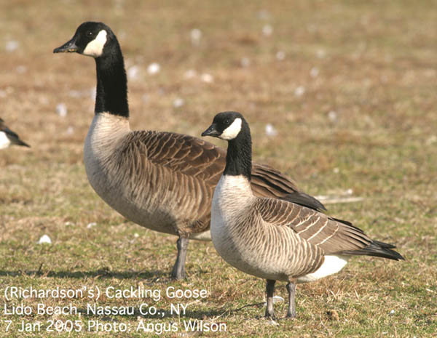
Two species!

Slide 69
Canada Goose and Cackling Goose; Anatidae; Anseriformes
Check out the difference in bill shape: Cackling is disproportionately shorter, more triangular

Slide 70
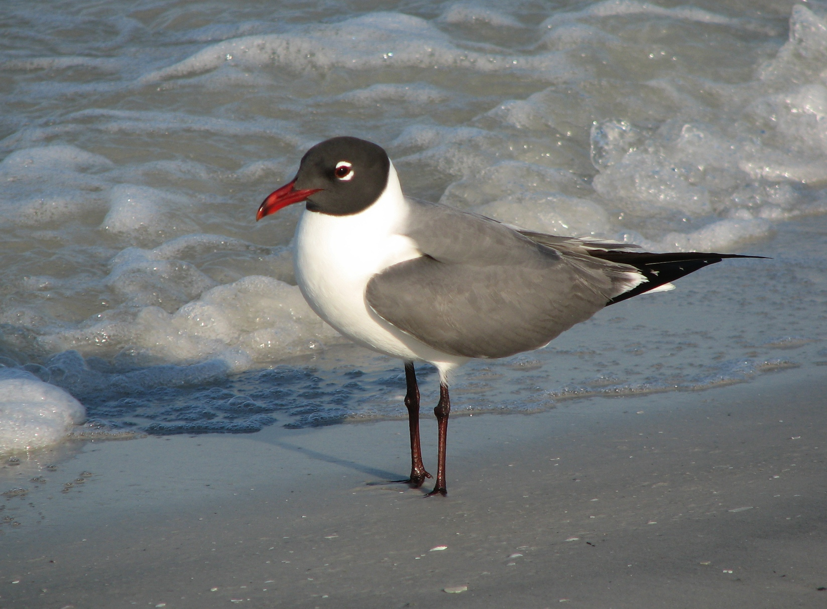

Slide 71
Notes:
Laughing Gull, Laridae, Charadriiformes. Only gull (note the bill) with dark head.

Slide 72
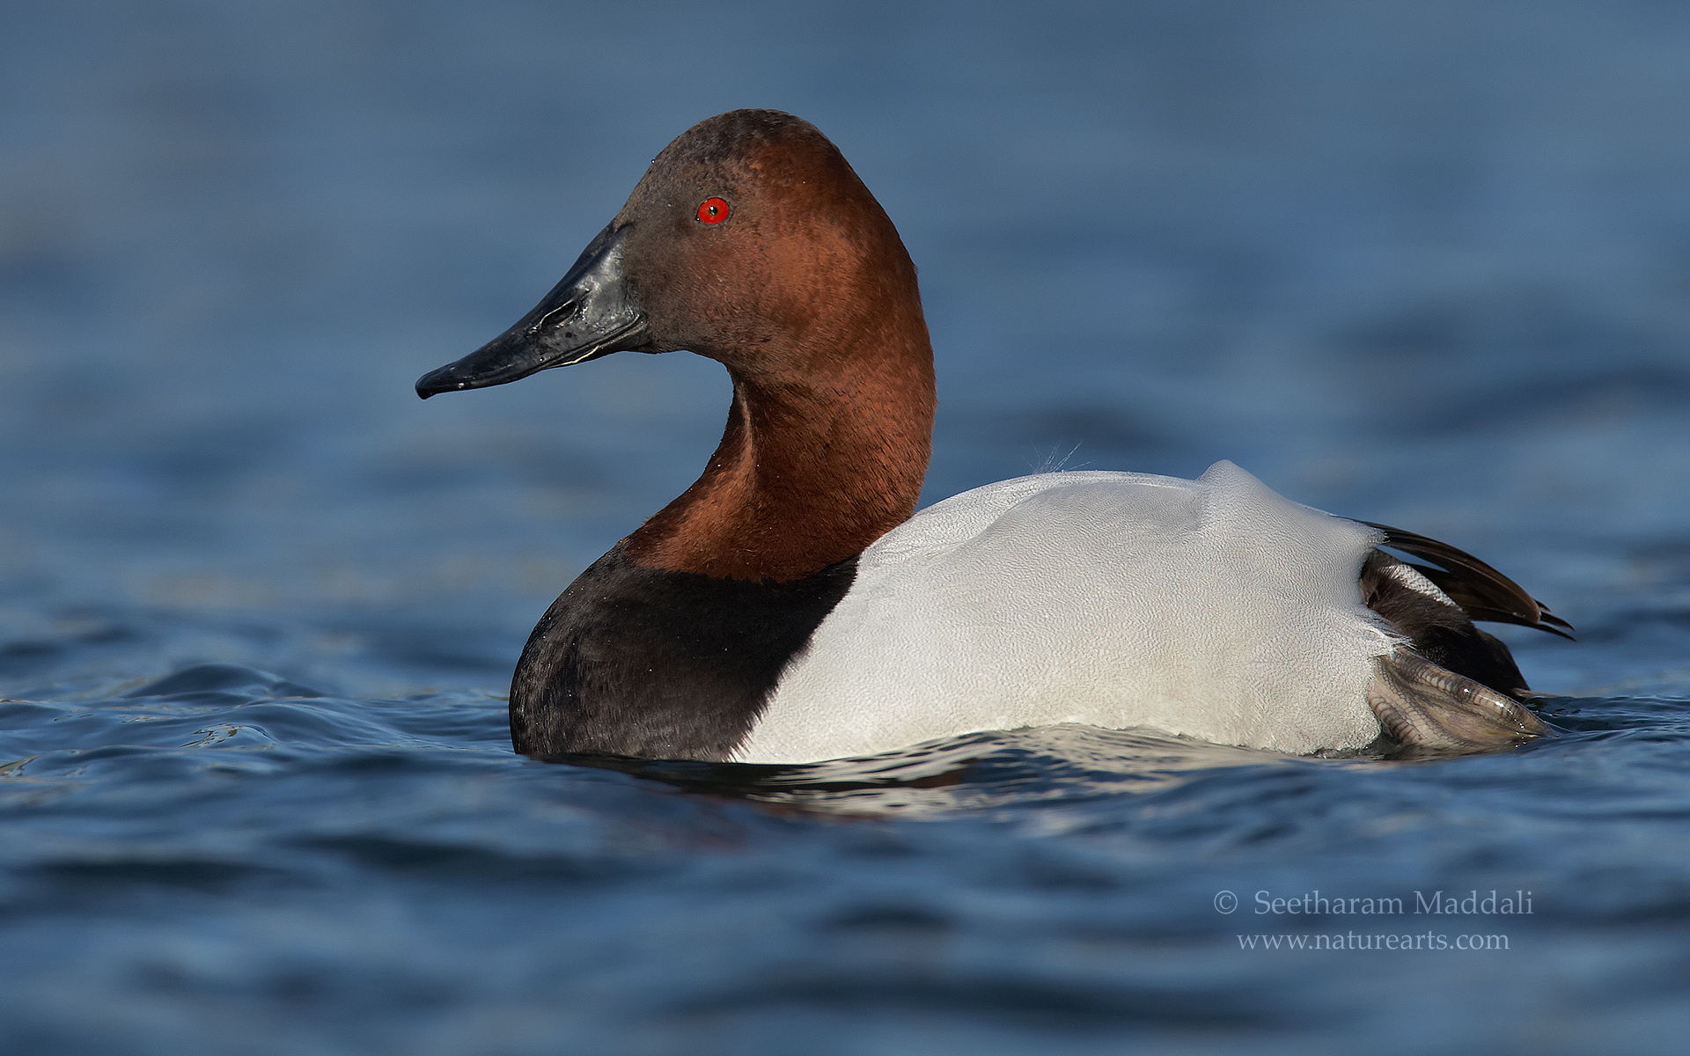

Slide 73
Reddish head, white back, black breast
Canvasback; Anatidae; Anseriformes

Slide 74
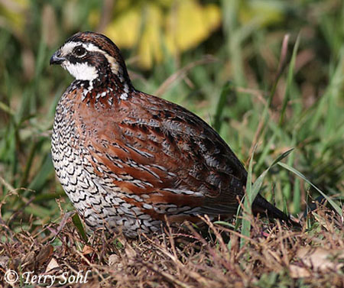

Slide 75
Unmistakable; those wavy dark markings on the breast and belly are distinctive
Northern Bobwhite; Odontophoridae; Galliformes

Slide 76
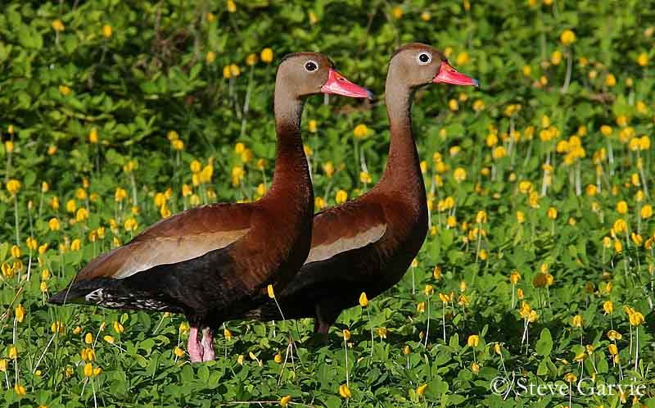

Slide 77
Black-bellied Whistling-Duck; Anatidae; Anseriformes
No other duck has plain face and solid black belly

Slide 78
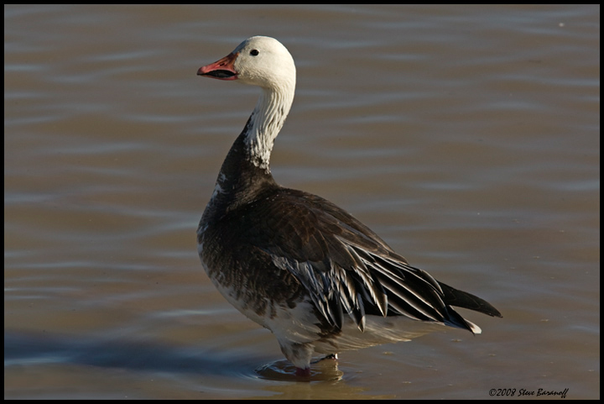
Tough one!

Slide 79
Snow Goose (blue phase); Anatidae; Anseriformes

Slide 80
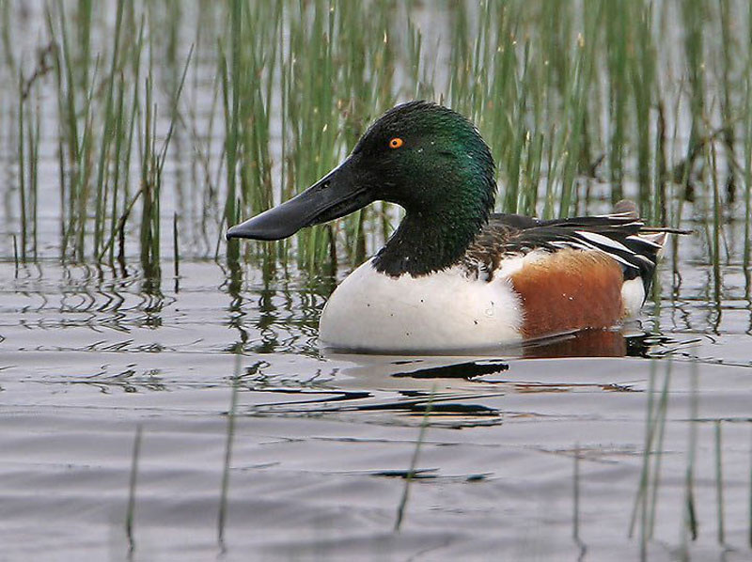

Slide 81
Expanded bill tip diagnostic
Northern Shoveler; Anatidae; Anseriformes

Slide 82
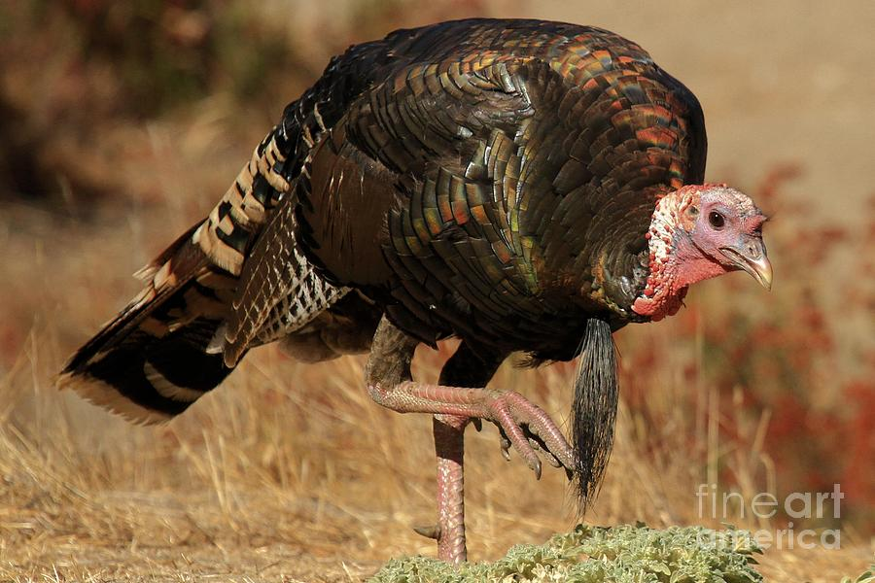

Slide 83
Nothing else has those colors and patterns on the back or wings
Wild Turkey; Phasianidae; Galliformes

Slide 84
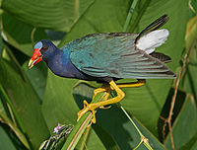

Slide 86
All you really have to see is the blue-green wings and white undertail coverts
Purple Gallinule; Rallidae; Gruiformes

Slide 87
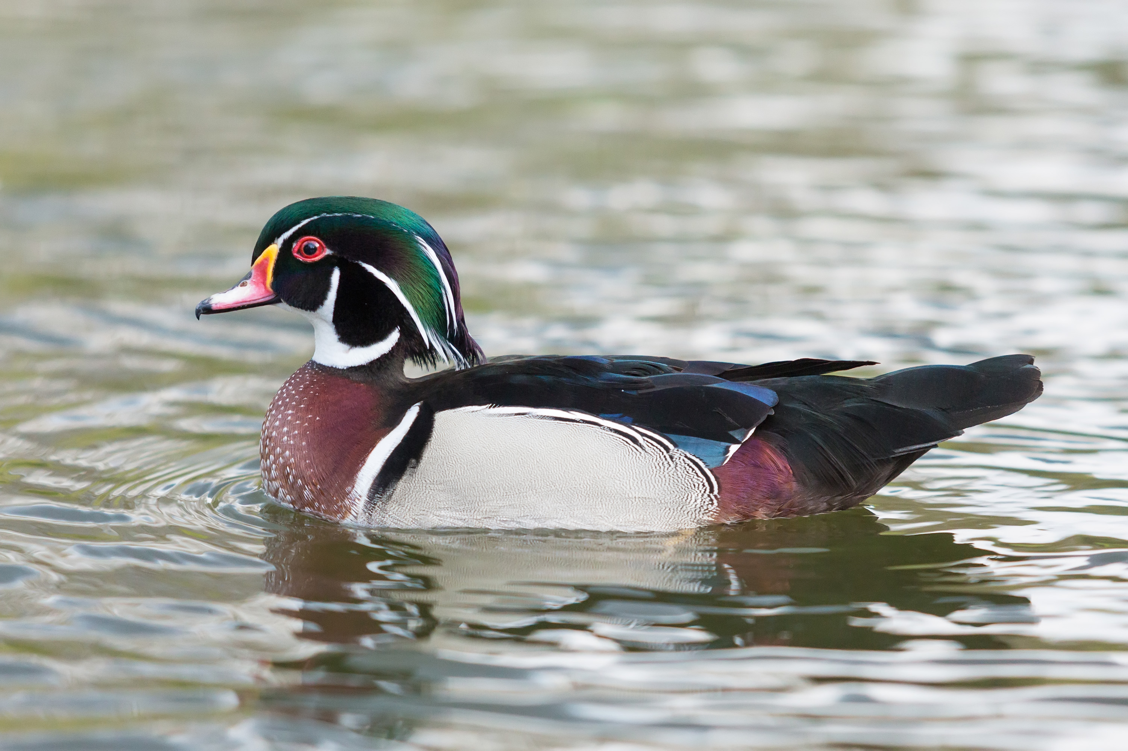
What else could it be?
Wood Duck; Anatidae; Anseriformes

Slide 88
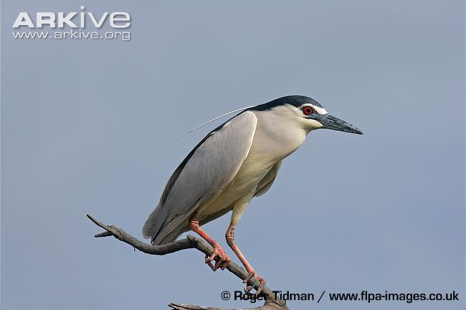

Slide 89
The only heron with a black crown and back, clean whitish underparts
Black-crowned Night Heron; Ardeidae; Pelecaniformes

Slide 90
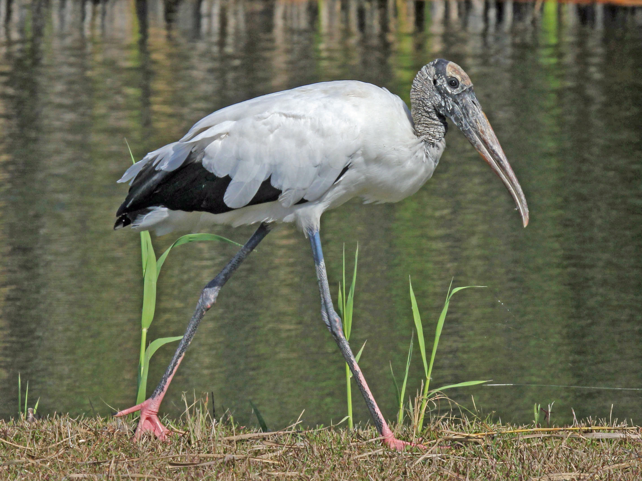

Slide 91
Bare head like a vulture; bill decurved at tip
Wood Stork; Ciconiidae; Ciconiiformes

Slide 92
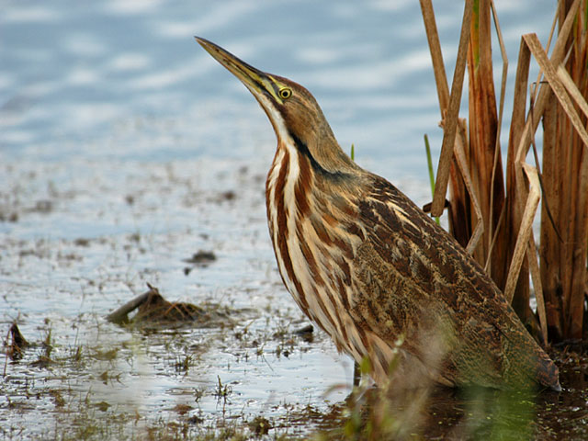

Slide 93
The only heron with complex, brown plumage; note the blackish malar
American Bittern; Ardeidae; Pelecaniformes

Slide 94
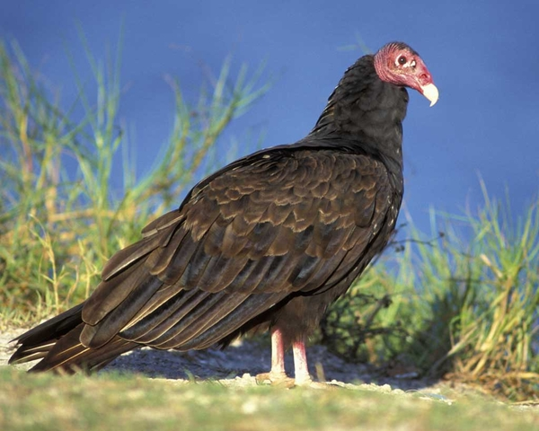

Slide 95
Specimens never have heads this red, but they are never blackish
Turkey Vulture; Cathartidae; Accipitriformes

Slide 96
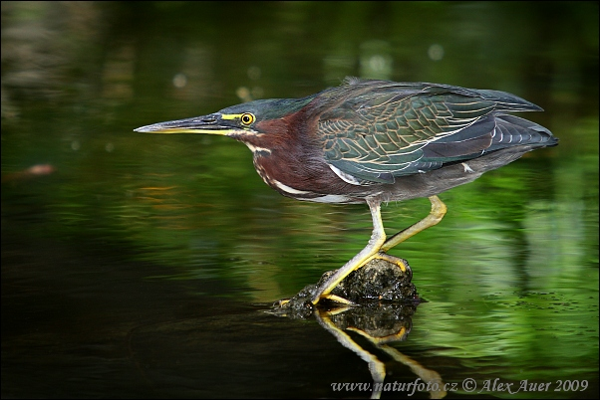

Slide 97
Small heron with green feathers in back, dark crown, dark reddish brown neck, breast, and face
Green Heron; Ardeidae; Pelecaniformes

Slide 98
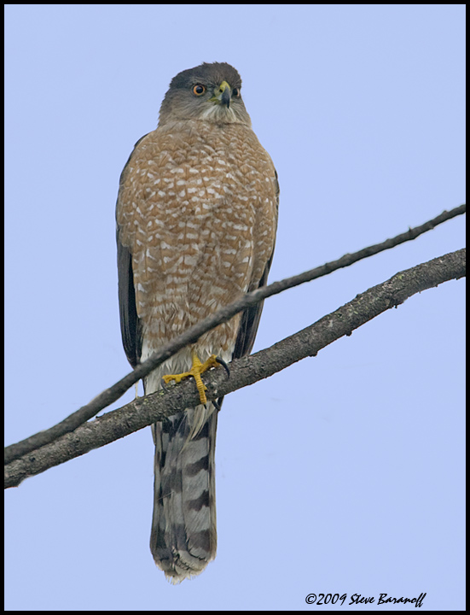

Slide 100
Tail has alternating dark grayish and paler grayish bands; outer rectrix shorter than inner rectrices, giving slightly rounded look to tail tip
Also note plain face; irregular reddish brown banding on underparts; long tail with
Cooper’s Hawk; Accipitridae; Accipitriformes

Slide 101
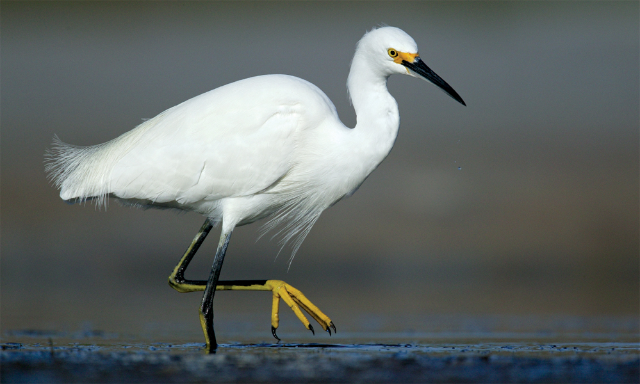

Slide 102
All white heron with black bill
Unfortunately the yellow feet don’t retain that color much in the specimens
Snowy Egret; Ardeidae; Pelecaniformes

Slide 103
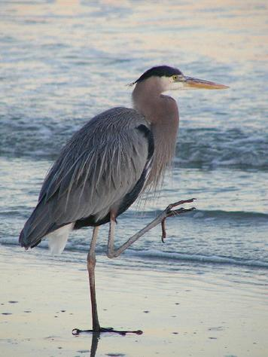

Slide 104
Large gray heron with black crown
Great Blue Heron; Ardeidae; Pelecaniformes

Slide 105
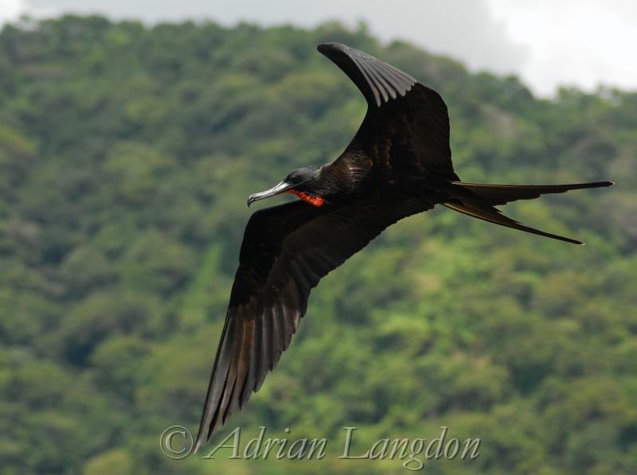

Slide 106
Large, black, long FORKED tail, hooked bill
Magnificent Frigatebird; Fregatidae; Suliformes

Slide 107
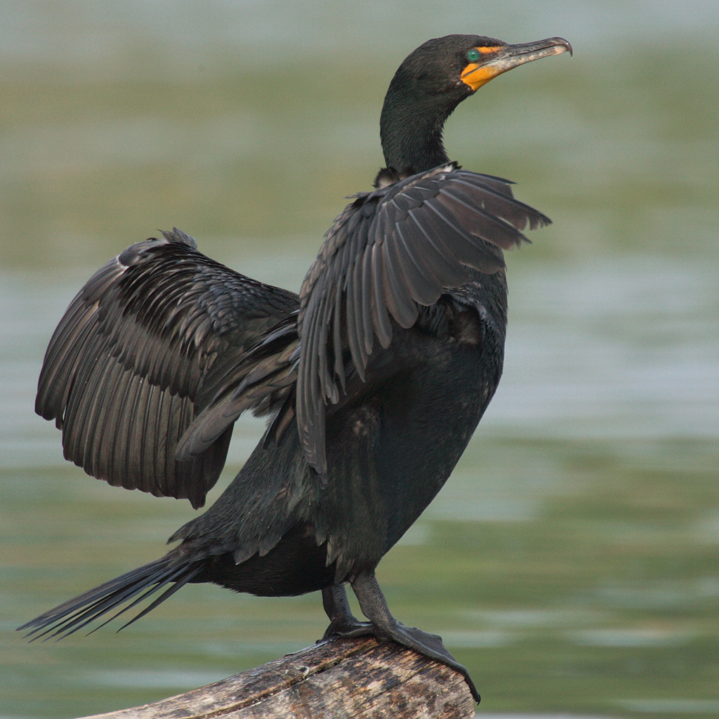

Slide 108
Large, black, relatively short tail, hooked bill; posterior border of facial skin relatively rounded; lores not feathered
Double-crested Cormorant; Phalacrocoracidae; Suliformes

Slide 109
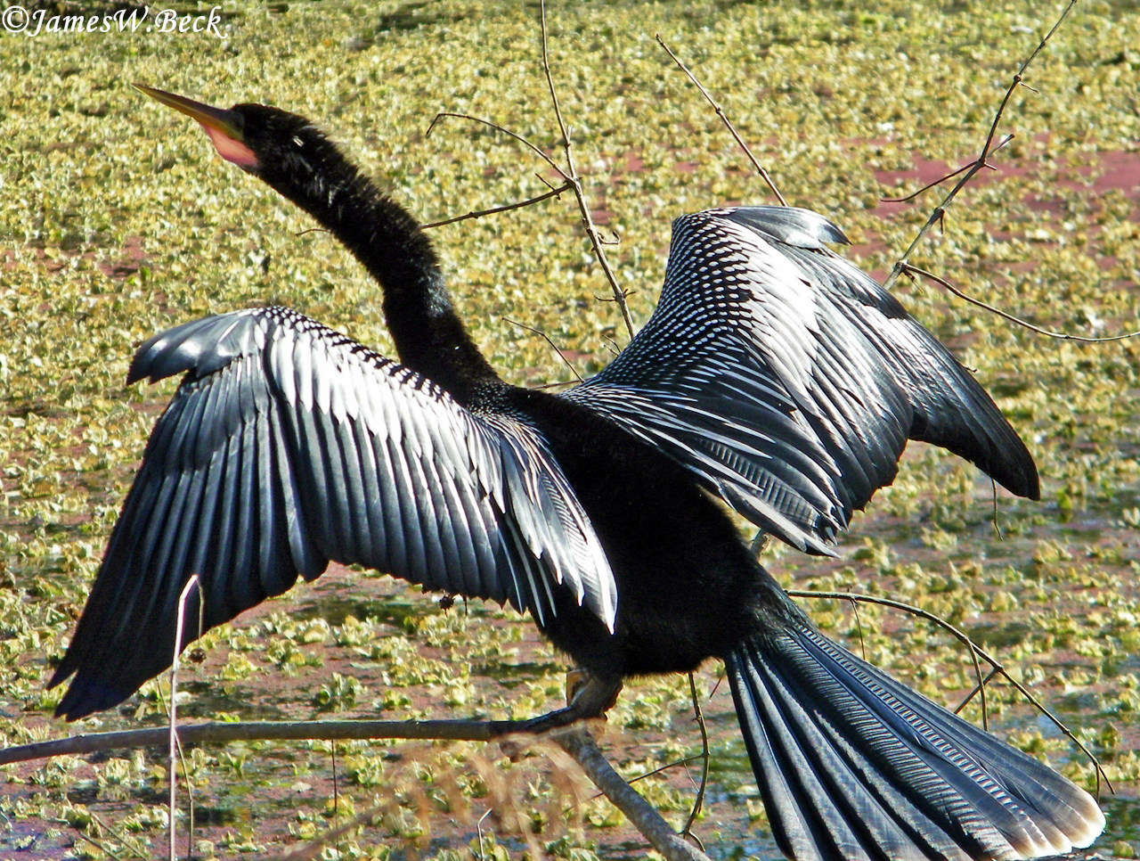

Slide 110
Large, black, relatively long tail, straight bill (no hook like cormorants); silvery feathers in upperwing coverts; notice corrugated central rectrices, tipped light brownish
Anhinga; Anhingidae; Suliformes

Slide 111
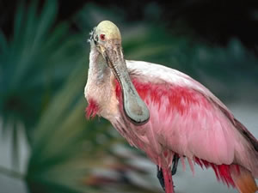

Slide 112
What else could it be?
Roseate Spoonbill; Threskiornithidae; Pelecaniformes

Slide 113
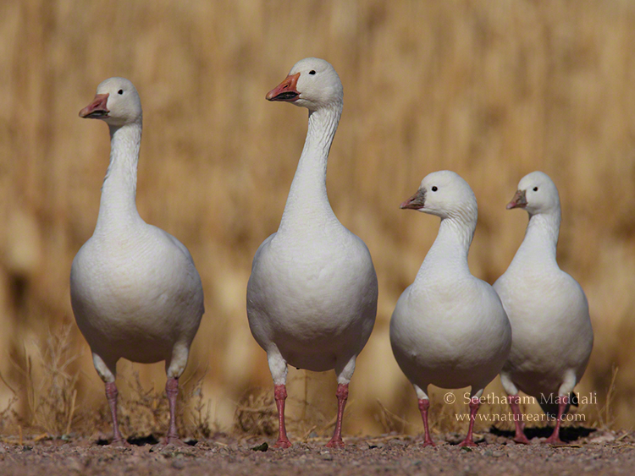
Two species

Slide 114
Check out the difference in bill shape: Ross’s is disproportionately shorter, more triangular
Snow Goose & Ross’s Goose; Anatidae; Anseriformes

Slide 115
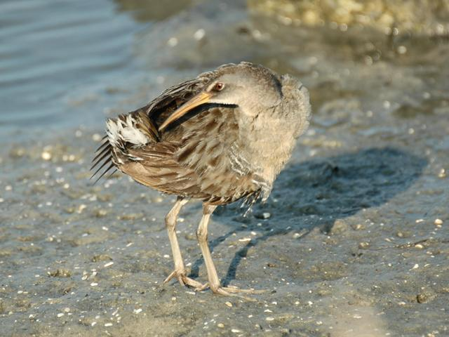

Slide 117
Note olive tones in upper wing coverts and back – lacks reddish brown shades of King Rail; also less reddish on breast.
Clapper Rail; Rallidae; Gruiformes

Slide 119
Notes:
Barred Owl, Strigidae, Strigiformes. Note the different pattern on breast from Great Horned Owl.

Slide 122
Green head, white neck ring, brown breast …
Mallard; Anatidae; Anseriformes

Slide 123
Now, make your own quiz using photos you can grab online, for the following page 1 species not represented here. (I may use the best ones for your future quizzes):
Trumpeter Swan
Hooded Merganser
Ring-necked Pheasant
Ruffed Grouse
Red-throated Loon
Common Loon
Red-necked Grebe
Laysan Albatross
Northern Fulmar
American White Pelican
Crested Caracara
Golden Eagle
California Condor
American Golden-Plover
American Oystercatcher
Ruddy Turnstone
Dunlin
Ring-billed Gull
Common Murre
Tufted Puffin
Greater Roadrunner
Snowy Owl

